Slide 1



Form A1: Participant Demographics
Presented by: Greg Jicha UKY ADRC
May 14, 2024 – UDSv4 Virtual Clinical Training Workshop

Slide 2
A1 Participant Demographics is designed to help us understand basic information on the participant
INSTRUCTIONS: This form may be completed by intake interviewer based on ADRC scheduling records, participant interview, medical records, and proxy co-participant report (according to what is deemed to be the most reliable source of information, except as indicated for specific questions that may be based on the participants perceptions and experience which only they can provide accurate information for).
Bottom line, try to use the best source of information whenever allowed to do so
This information can be collected by mail-in survey, electronic capture (web-based), phone or video interview, or during the in-person visit to accommodate and lessen participant visit burden.
Collect this information when it best fits into your site’s planned visit schedule
For additional clarification and examples, see the UDS Coding Guidebook, Form A1.
Always refer to the coding guidebook if questions arise
Check only one box per question unless otherwise specified.
Make sure you pay attention to question specific instructions

Slide 3
This form has 3 sections
SECTION 1: DEMOGRAPHICS (Participant facing but you should always use the best source)
SECTION 2: SUBJECTIVE MEMORY COMPLAINTS (Participant only should answer questions as these will be repeated for the study partner in Form A2)
SECTION 3: ADRC staff coding (ADI, Occupation, Enrollment type, & Referral source)

Slide 4
All forms will start with a brief description of data collection processes
Language of administration
In-person or remote?
Reason for remote?

Slide 5
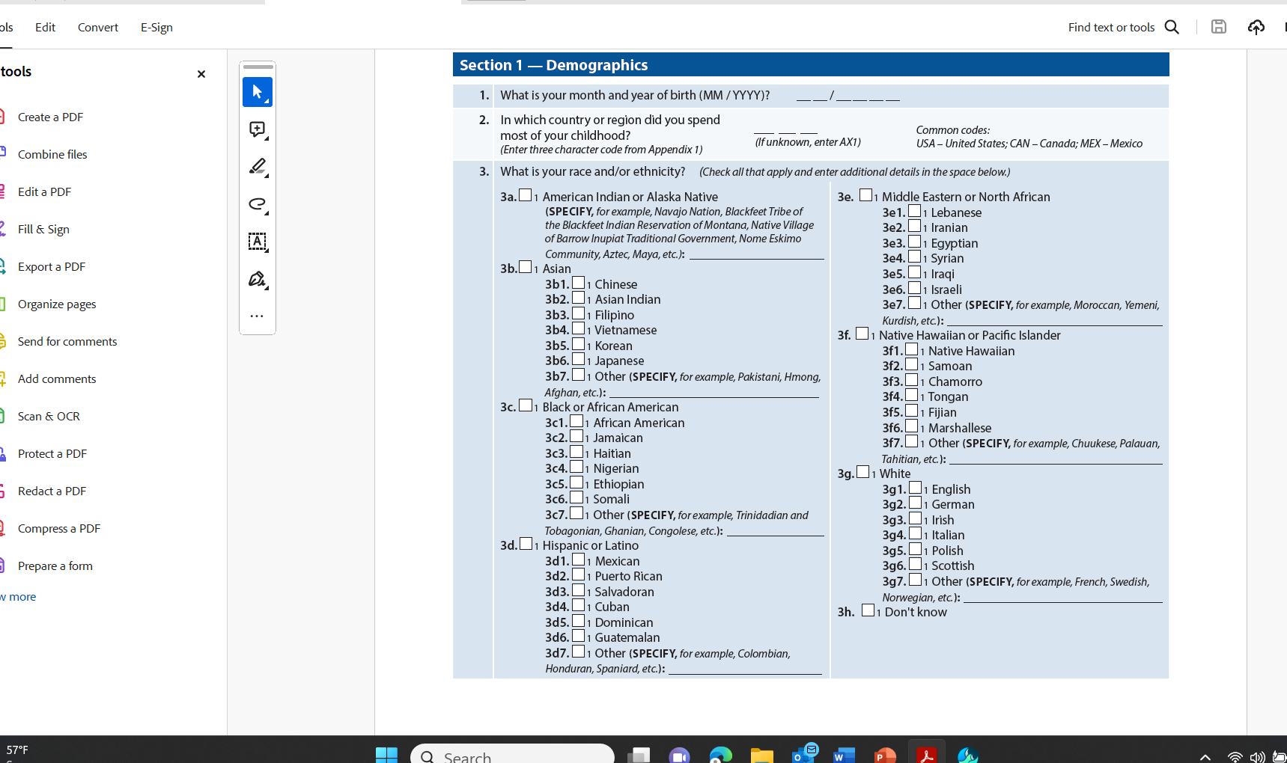
Codes are included as Appendix 1 that are part of the form
ADRC staff should help identify the proper code

Slide 6
Simply check all that apply

Slide 7
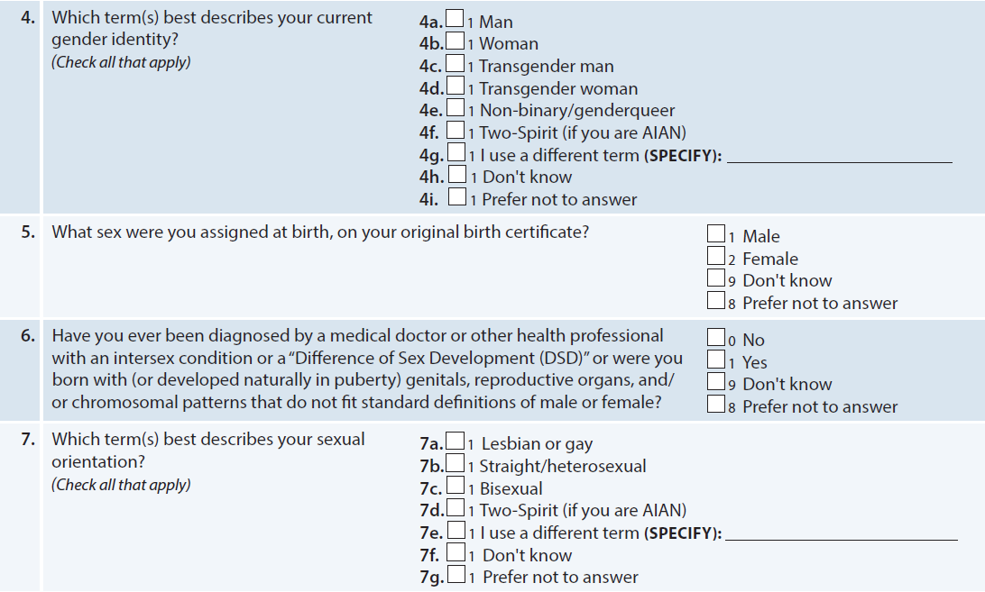
Gender identity & sexual orientation
The next four questions ask about your gender identity, sex assigned at birth, sexual orientation, and intersex status.
This information
will be used to help us improve health, well-being, and quality of care. By gender identity, we mean the inner sense that you have of yourself as being a man, woman, or a different gender.
Gender identity can be different from your sex assigned at birth or your sexual
orientation, and it can change over time.

Slide 8
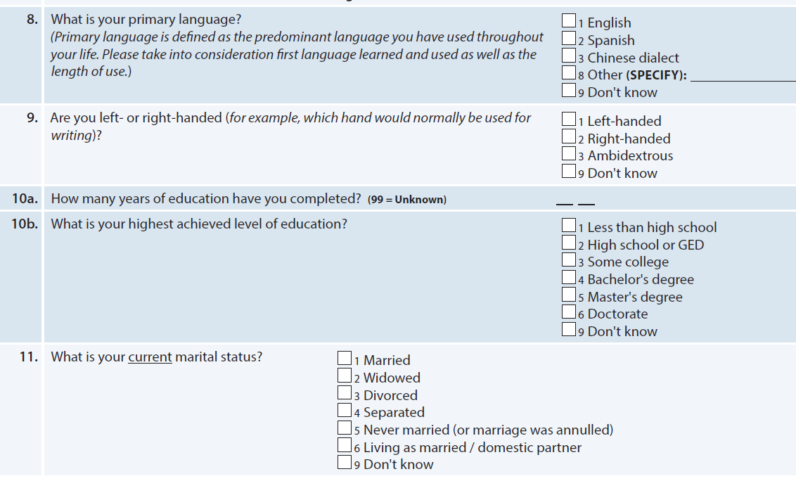
These should all be straightforward…

Slide 9
Living situation questions may seem redundant, but they really get at both residence type (Q13), and degree of live-in support (Q12)
ZIP (First three help with geographic region while limiting Identifying information)

Slide 10
Veteran Status is an important variable
Physical engagement/exercise simply did not fit anywhere else but is an important data point

Slide 11
Subjective memory complaints (Short 3-item)
*Participant only should answer, same three questions are on Form A2 for informant
**Centers can and should expand with e-cog or other instrument as desired

Slide 12
ADI & Modified Hollingshead Occupation Index
Codes are included as Appendix 1 that are part of the form
ADRC staff should identify the proper code, but make sure you ask about occupation from the best source

Slide 13
Form A2: Co-participant Demographics
Presented by: Greg Jicha UKY ADRC
May 14, 2024 – UDSv4 Virtual Clinical Training Workshop

Slide 14
A2- Co-participant demographics
INSTRUCTIONS: This form is to be completed by intake interviewer based on co-participant’s report. This form should not be provided directly to the co-participant. For additional clarification and examples, see the UDS Coding Guidebook for Form A2. Check only one box per question.
There are only two short sections for this form
None of the questions ask information about the co-participant beyond their interactions with the participant
Section 1: Co–participant's Relationship to Participant
  Relationship to participant, how long have they known them, how do they interact and how often
  Separate question on perceived reliability of co-participant given that CDR, FAS, NPI and other items may be reported by the co-participant
Section 2: Co–participant's Judgment of Participant's Memory
  Short 3 item subjective memory complaint scale

Slide 15
These are simple questions that should be self explanatory
This should not be asked of or shared with the co-participant

Slide 16
Subjective memory complaints (Short 3-item)
*Participant only should answer, same three questions are on Form A2 for informant
**Centers can and should expand with e-cog or other instrument as desired

Slide 17
Thank you!

Slide 18

Connect
Greg Jicha, MD-PhD
gregory.jicha@uky.edu

