Slide 1
Form A1a: Social Determinants of Health (SDOH)
Presented by: Lisa L. Barnes, PhD and Megan Zuelsdorff, PhD
For the SDOH Working Group of the CTF
May 14, 2024 – UDSv4 Virtual Clinical Training Workshop

Slide 2
Data gaps are a barrier to equitable ADRD science
Disparities in ADRD and research representation
Minoritized Status
(Race, Ethnicity)
Imprecise Proxy
Vascular Risk
Brain Health
Eligibility
Participation
Retention
Cognitive Function

Slide 3
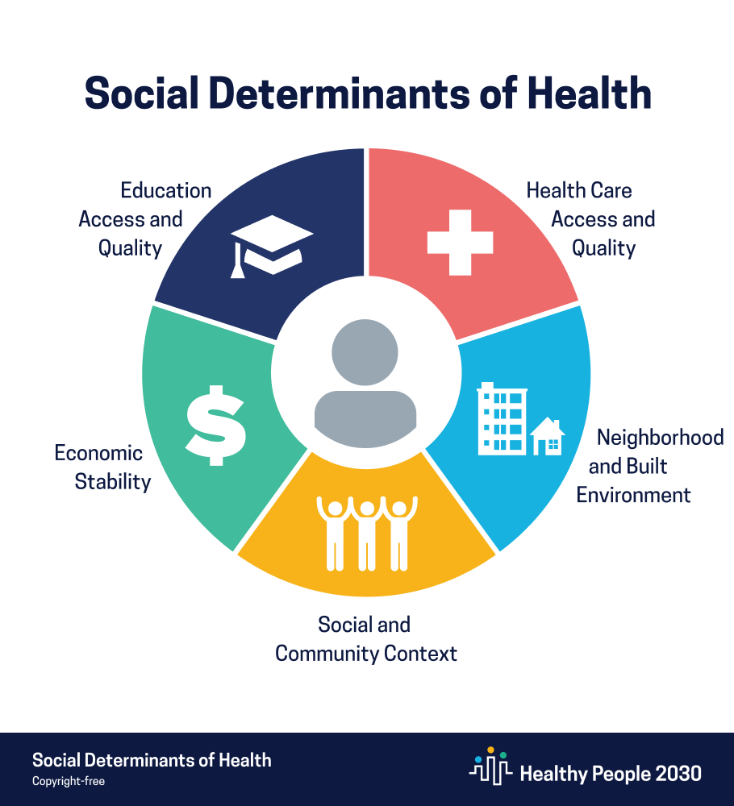
Why a new form on SDOH?
conditions in the environments where people are born, live, learn, work, play, and age
Non-medical factors that influence health outcomes

Slide 4
Form A1a: SDOH
Purpose
Collect data on social conditions of our participants
Represent risk/protective factors beyond what can be gathered from ADI or other public databases
Constructs
Section 1: Transportation
Section 2: Financial Security
Section 3: Social connections, activities, and environment
Section 4: Experiences with healthcare system
Section 5: Experiences of discrimination

Slide 5
Form A1a: SDOH
Key Points
How should it be administered?
Self-administered by participant (not co-participant) or administered by ADRC staff directly with participant
Who should receive the form?
Participants with a CDR < 1 (NCI or MCI ok)
How long does it take?
5 – 8 minutes based on pilot testing of older adults without cognitive impairment
How often should we give it?
Mandatory for the initial UDSv4 visit packet
It can be given every year; encouraged but not required to measure changes in SDOH over time

Slide 6
Form A1a: Utilization and Scoring Overview
Key Points
Five major constructs often include sub-constructs drawn from different sources/scales
All item responses should be recorded individually and not summed at the data-entry stage
Scoring and data utilization will be study-specific
Validation studies, empirical utilization, and recommendations forthcoming in a publication on module development process

Slide 7
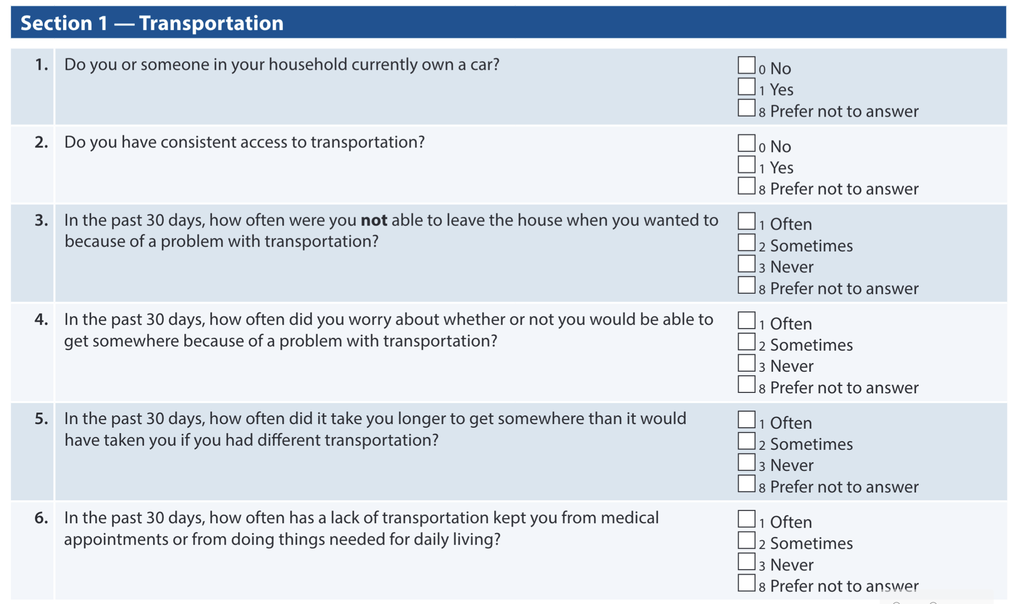
Form A1a: Transportation Security
First two questions created and added as independently important with committee member consensus
Four questions drawn from validated Transportation Security Index and can be summed to create an index score
Murphy, Alexandra K., Alix Gould-Werth, and Jamie Griffin. 2021. “Validating the Sixteen-Item Transportation Security Index in a Nationally Representative Sample: A Confirmatory Factor Analysis.” Survey Practice 14 (1). https://doi.org/10.29115/SP-2021-0011.

Slide 8
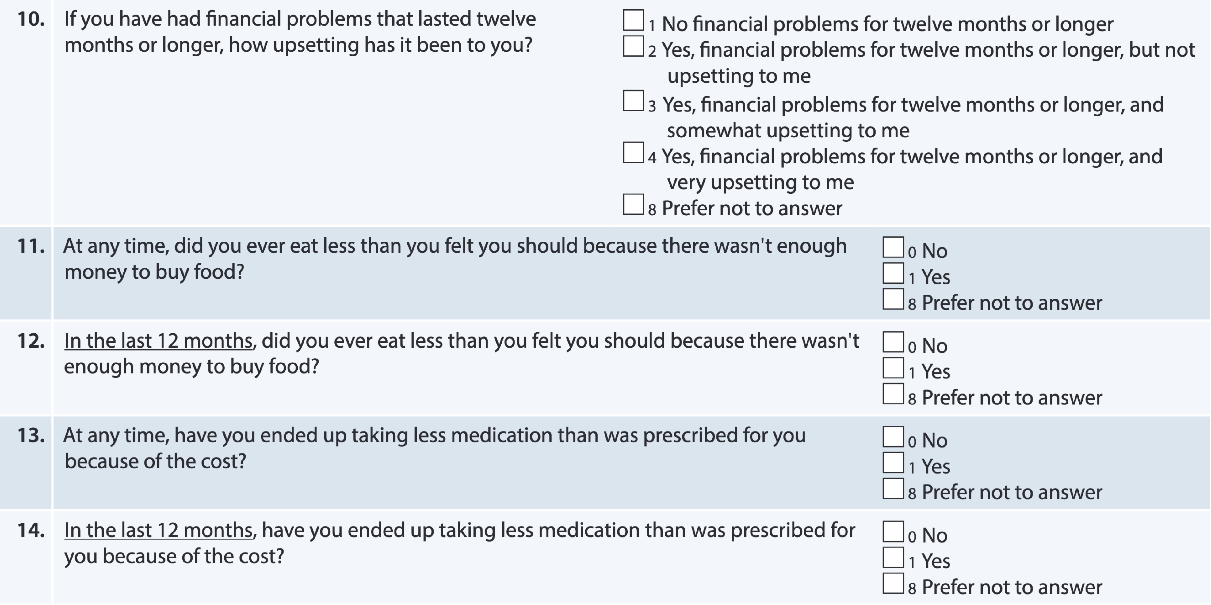
Form A1a: Financial Stress
Income question originally added to A1 (Demographics)
Questions from the Health and Retirement Study (HRS)
Recent (“In the last 12 months”) versions added based on ADRC feedback and committee consensus
Items originally selected for HRS based on their prevalent use as measures of objective and subjective financial hardship
Have been used individually or summed as index scores in various ways for studies across health and social science journals

Slide 9
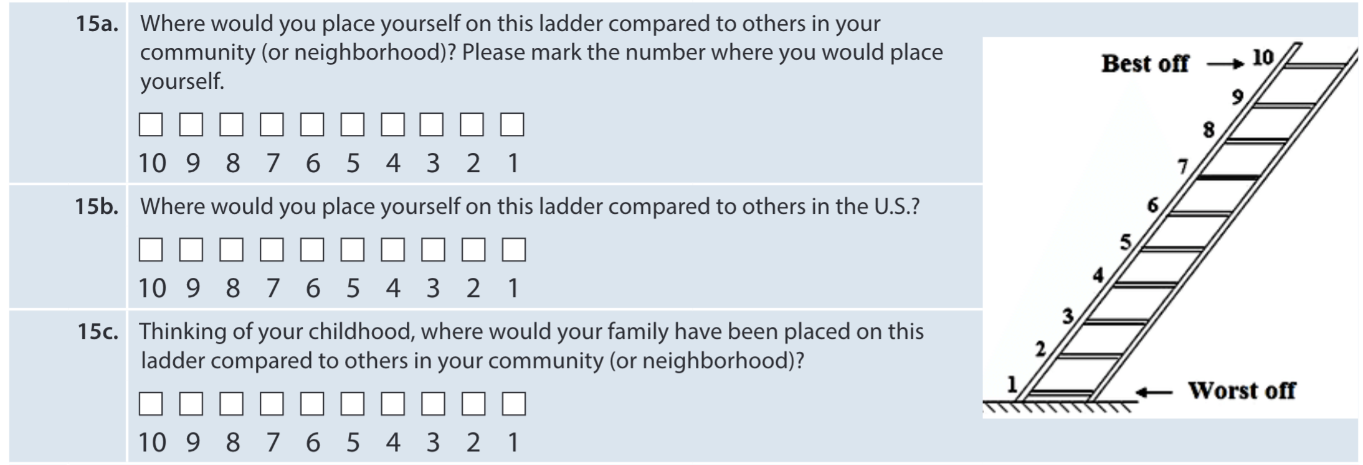
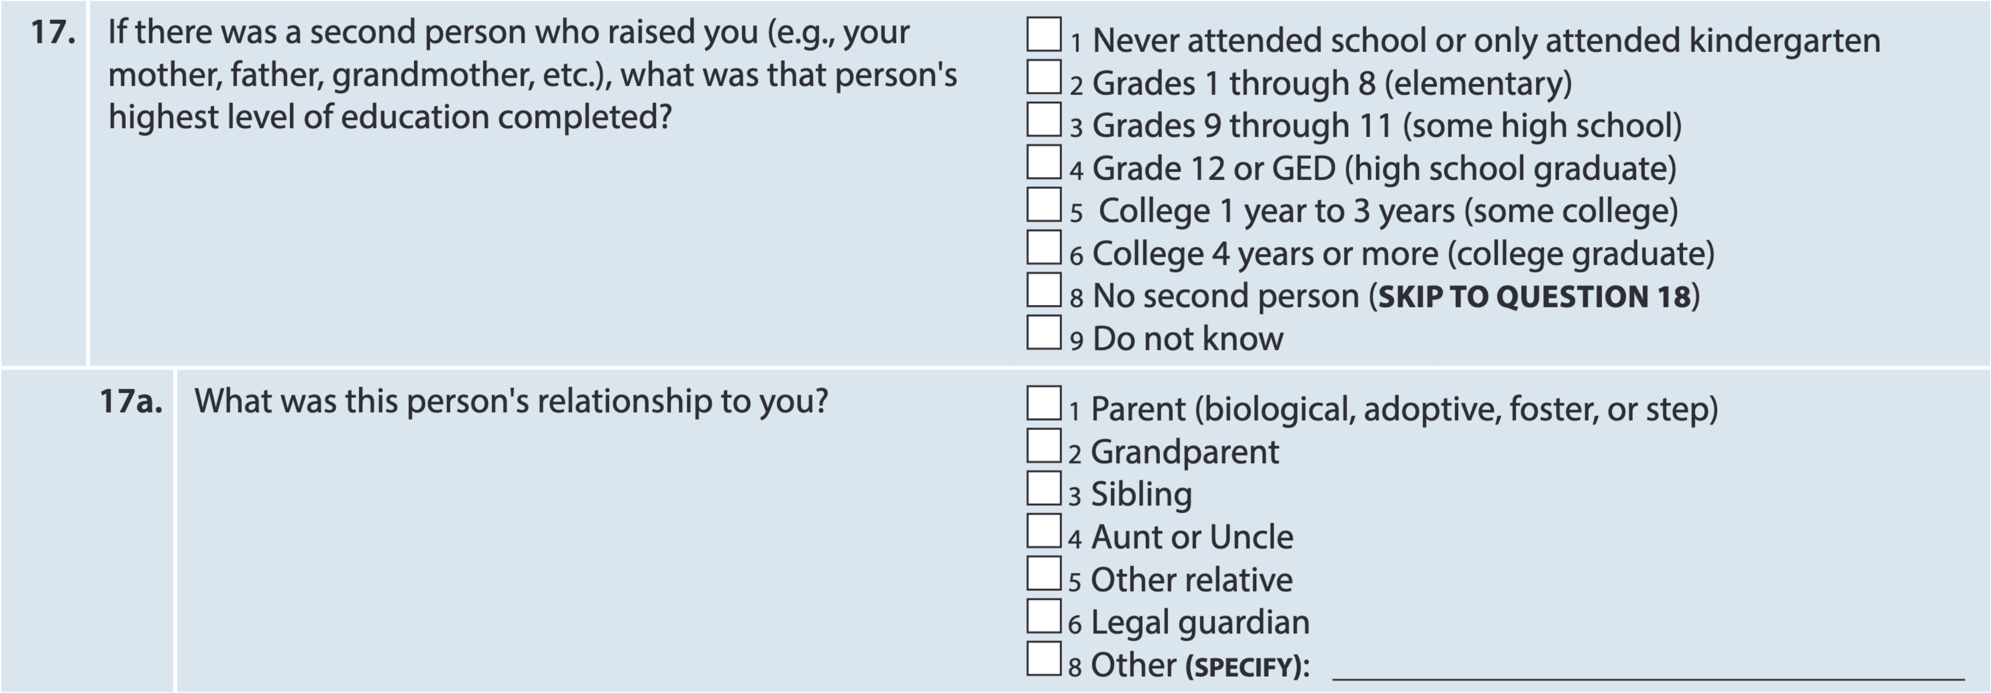
Form A1a: Financial Stress, Cont’d
MacArthur Scale of Subjective Social Status (“MacArthur Ladder”
Robustly predicts morbidity, mortality, physical and psychological well-being
Each item can be used as a simple continuous score or collapsed into categories
Adler NE, Epel ES, Castellazzo G, Ickovics JR. Relationship of subjective and objective social status with psychological and physiological functioning: preliminary data in healthy white women. Health Psychol. 2000 Nov;19(6):586-92. doi: 10.1037//0278-6133.19.6.586. PMID: 11129362.
Social and Economic Status - Intergenerational
Added based on ADRC feedback and committee consensus
Maternal educational attainment commonly used measure of early life SES

Slide 10
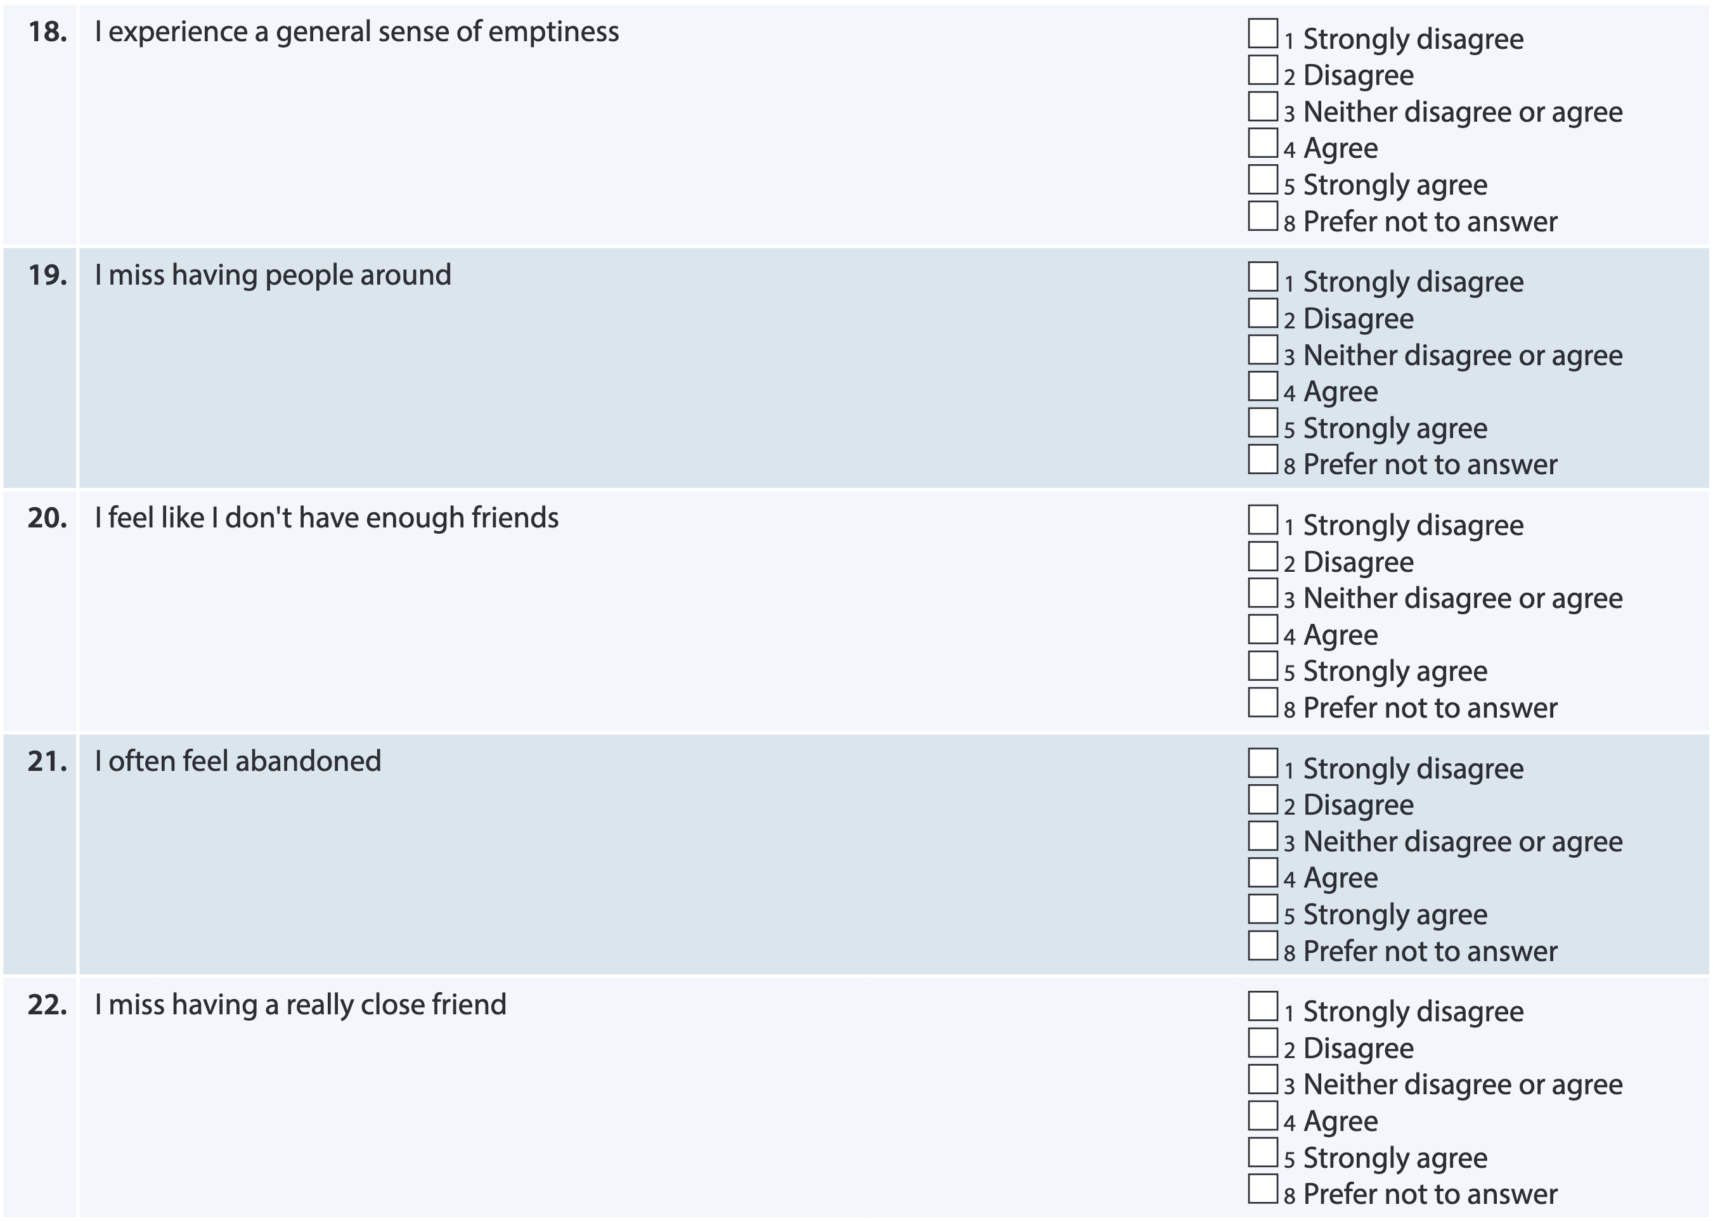
Social Connections, Activities, and Environment
Loneliness/Emotional Isolation
Modified version of DeJong Giervald Loneliness Scale
Items used in Rush ADRC protocol
Most often summed to create index score
Gierveld, J. D. J., & Tilburg, T. V. (2006). A 6-Item Scale for Overall, Emotional, and Social Loneliness: Confirmatory Tests on Survey Data. Research on Aging, 28(5), 582-598.
Wilson RS, Krueger KR, Arnold SE, Schneider JA, Kelly JF, Barnes LL, Tang Y, Bennett DA. Loneliness and risk of Alzheimer disease. Arch Gen Psychiatry. 2007 Feb;64(2):234-40. doi: 10.1001/archpsyc.64.2.234. PMID: 17283291.

Slide 11
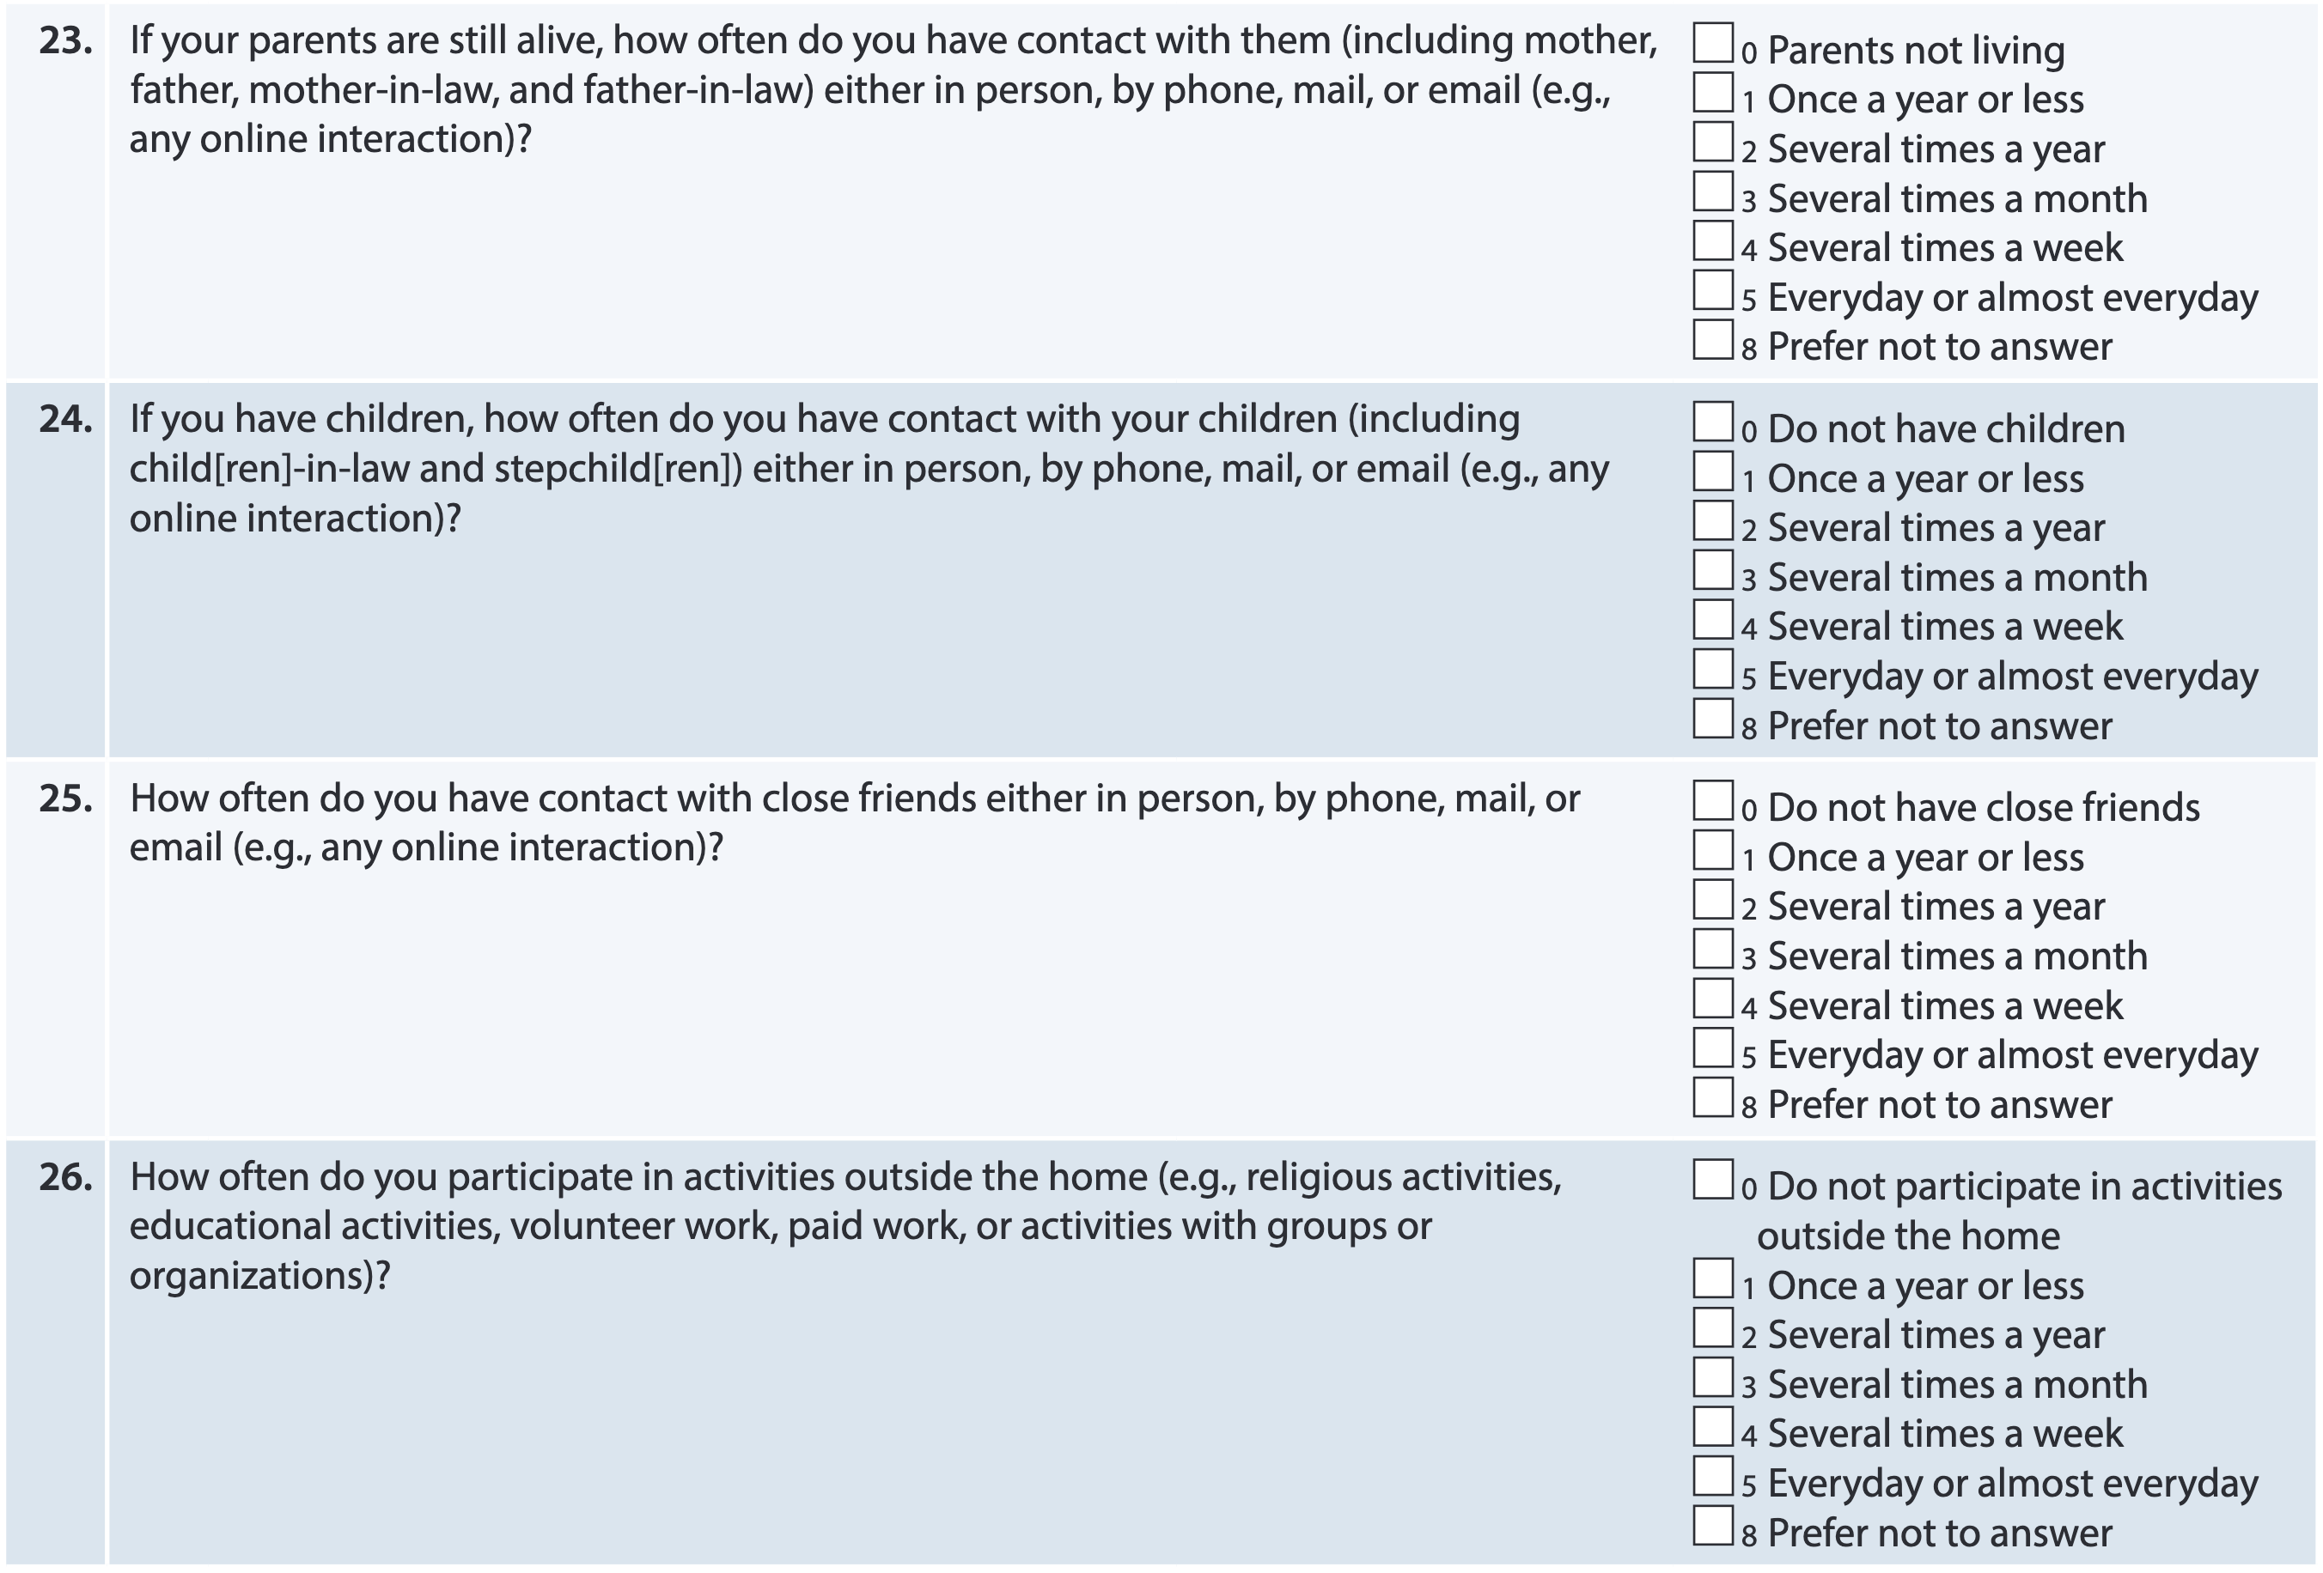
Form A1a: Social Connections, Cont’d
Social Engagement/Activities
Multiple domains of interaction represented
Can be used individually or summed for an index score
Adapted from RADC cohorts and based on ADC feedback and committee consensus
Home and neighborhood safety question originally added to A1 (Demographics)

Slide 12
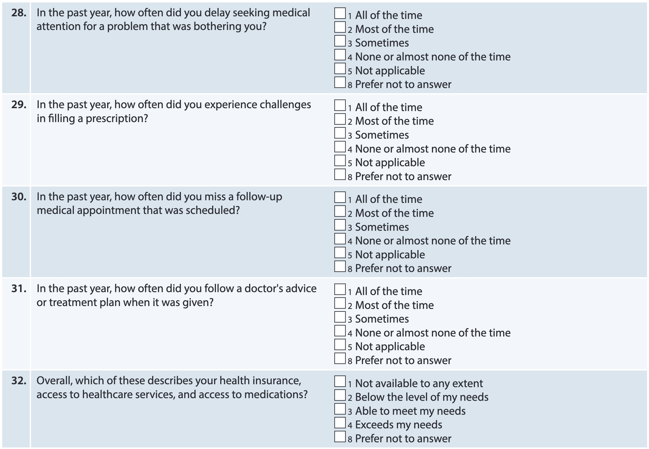
Form A1a: Healthcare Experiences
Healthcare Access
Adapted from items in a study of discrimination and healthcare experiences
Can be used individually or summed for an index score
For index scores, some items will need reverse coding
Van Houtven CH, Voils CI, Oddone EZ, Weinfurt KP, Friedman JY, Schulman KA, Bosworth HB. Perceived discrimination and reported delay of pharmacy prescriptions and medical tests. J Gen Intern Med. 2005 Jul;20(7):578-83. doi: 10.1111/j.1525-1497.2005.0123.x. PMID: 16050850; PMCID: PMC1490147.

Slide 13
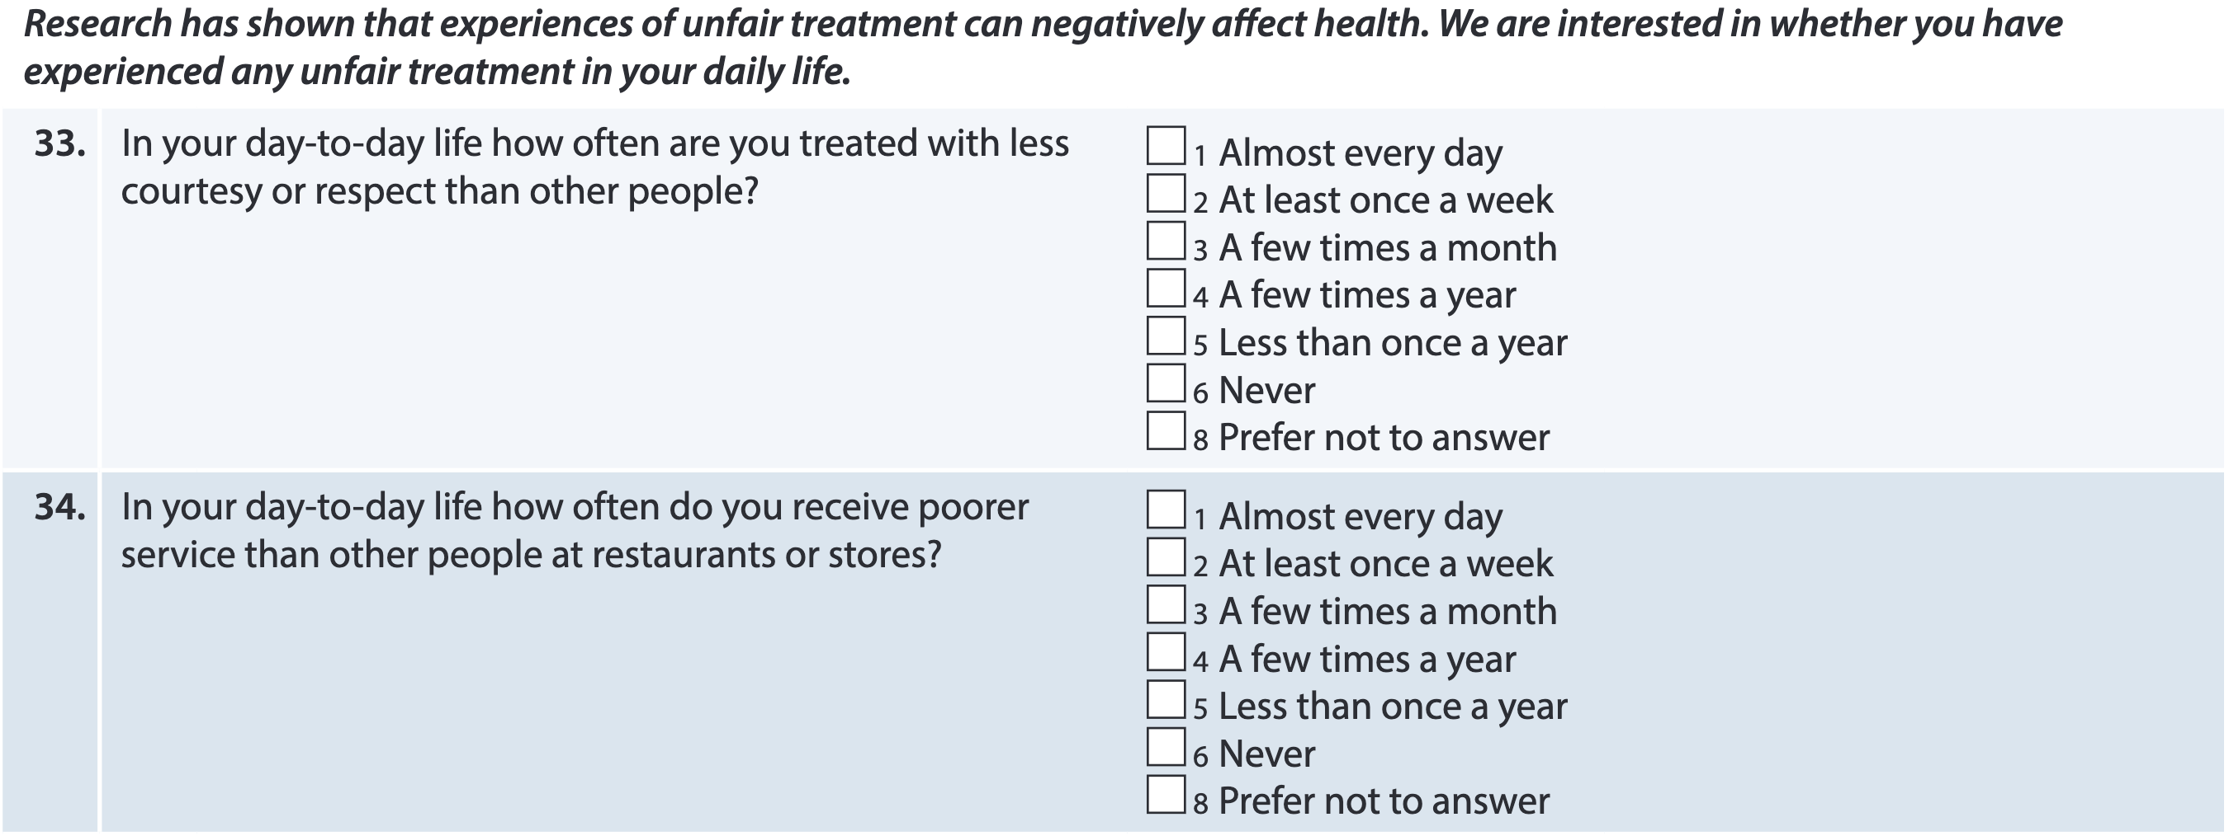
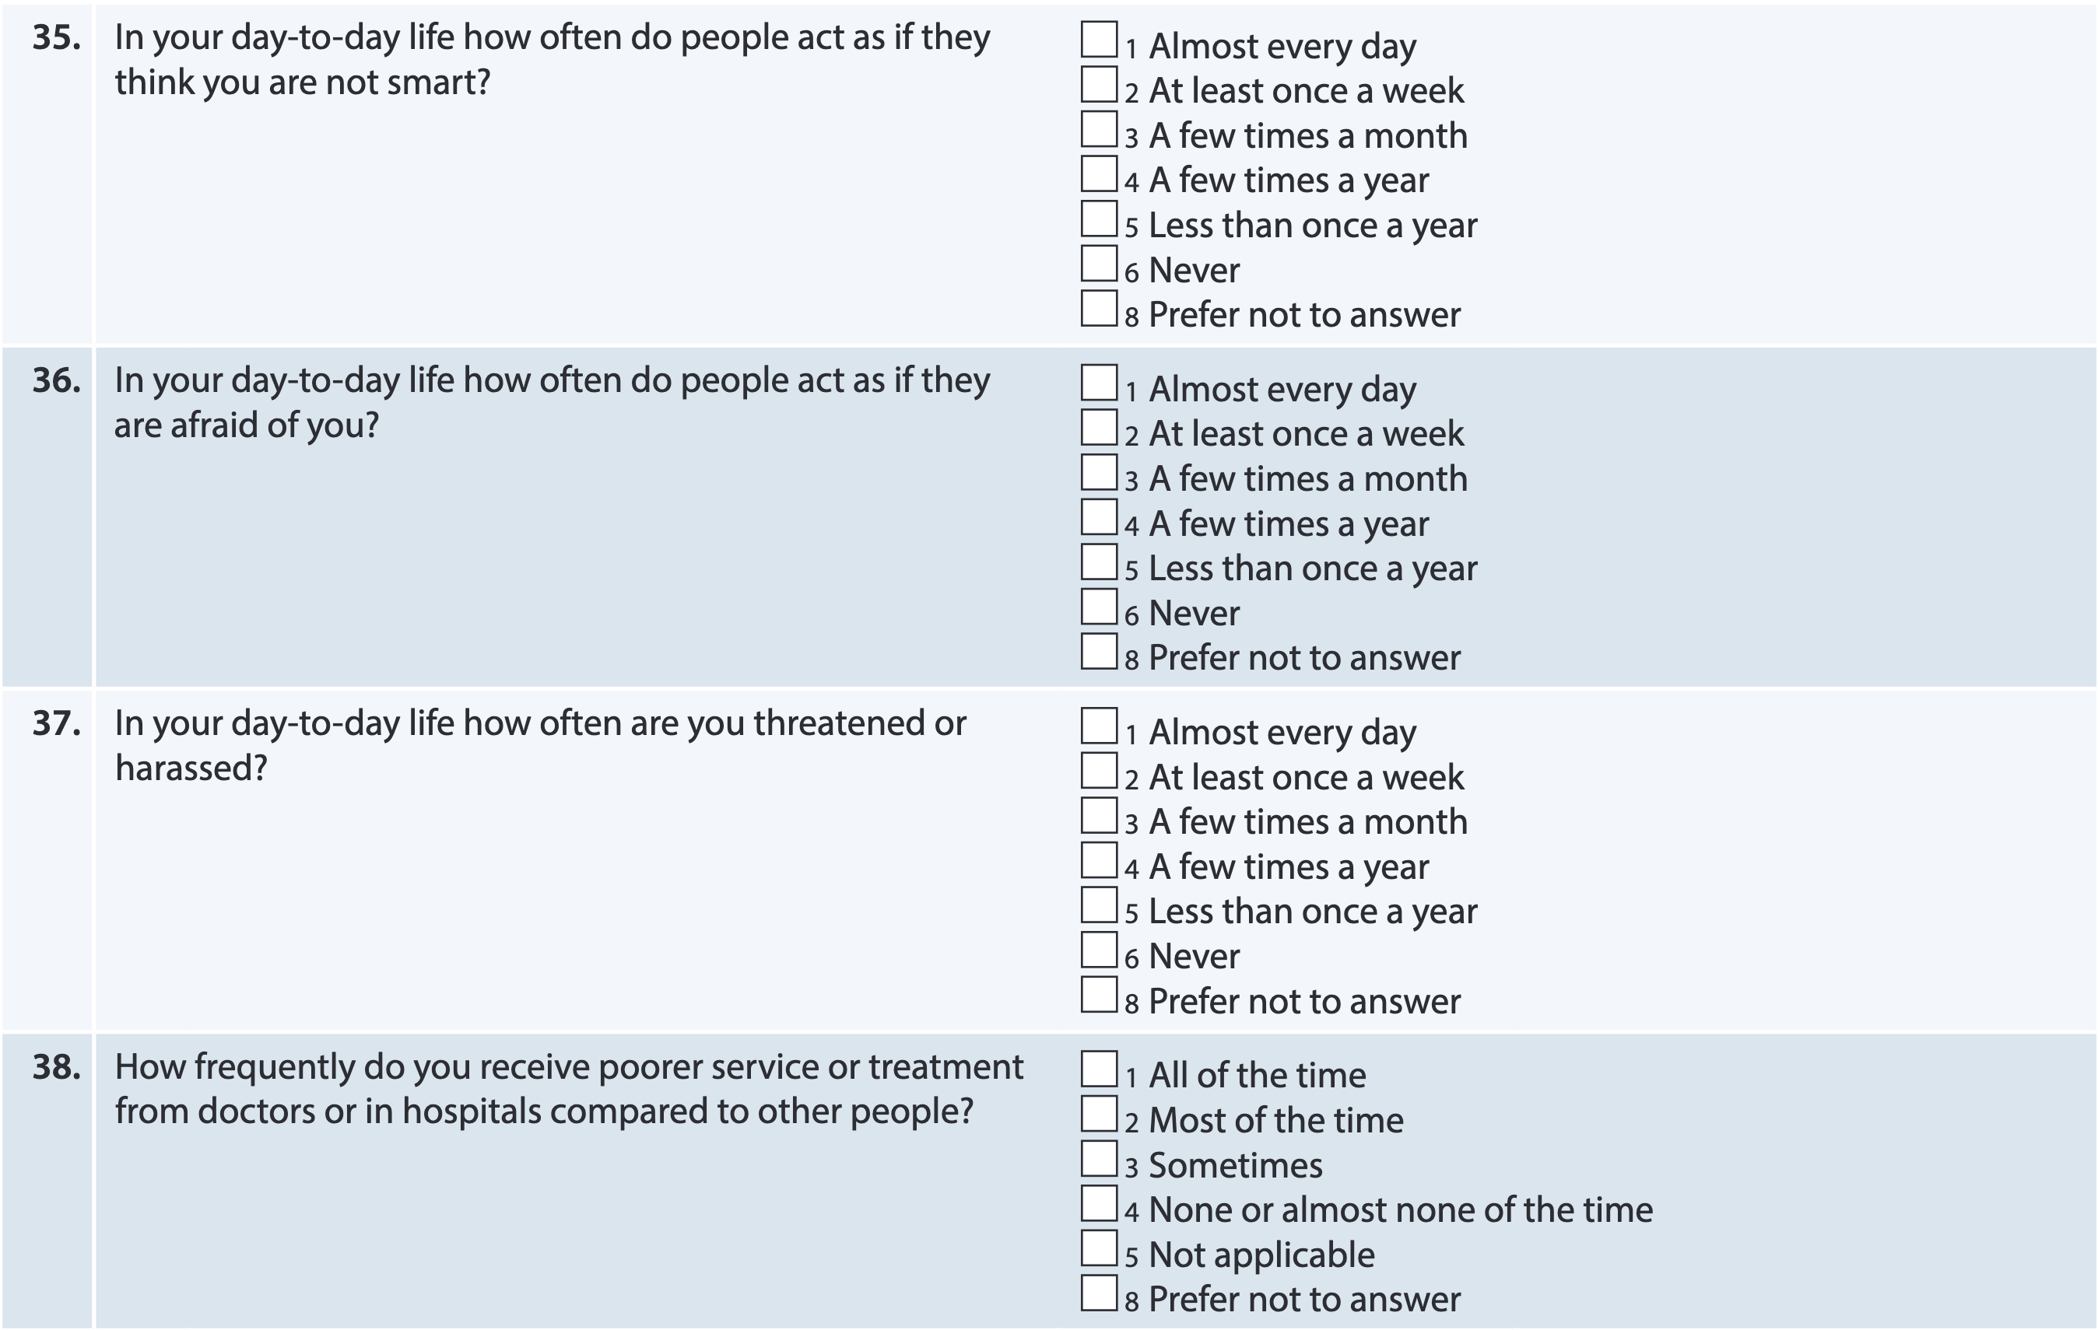
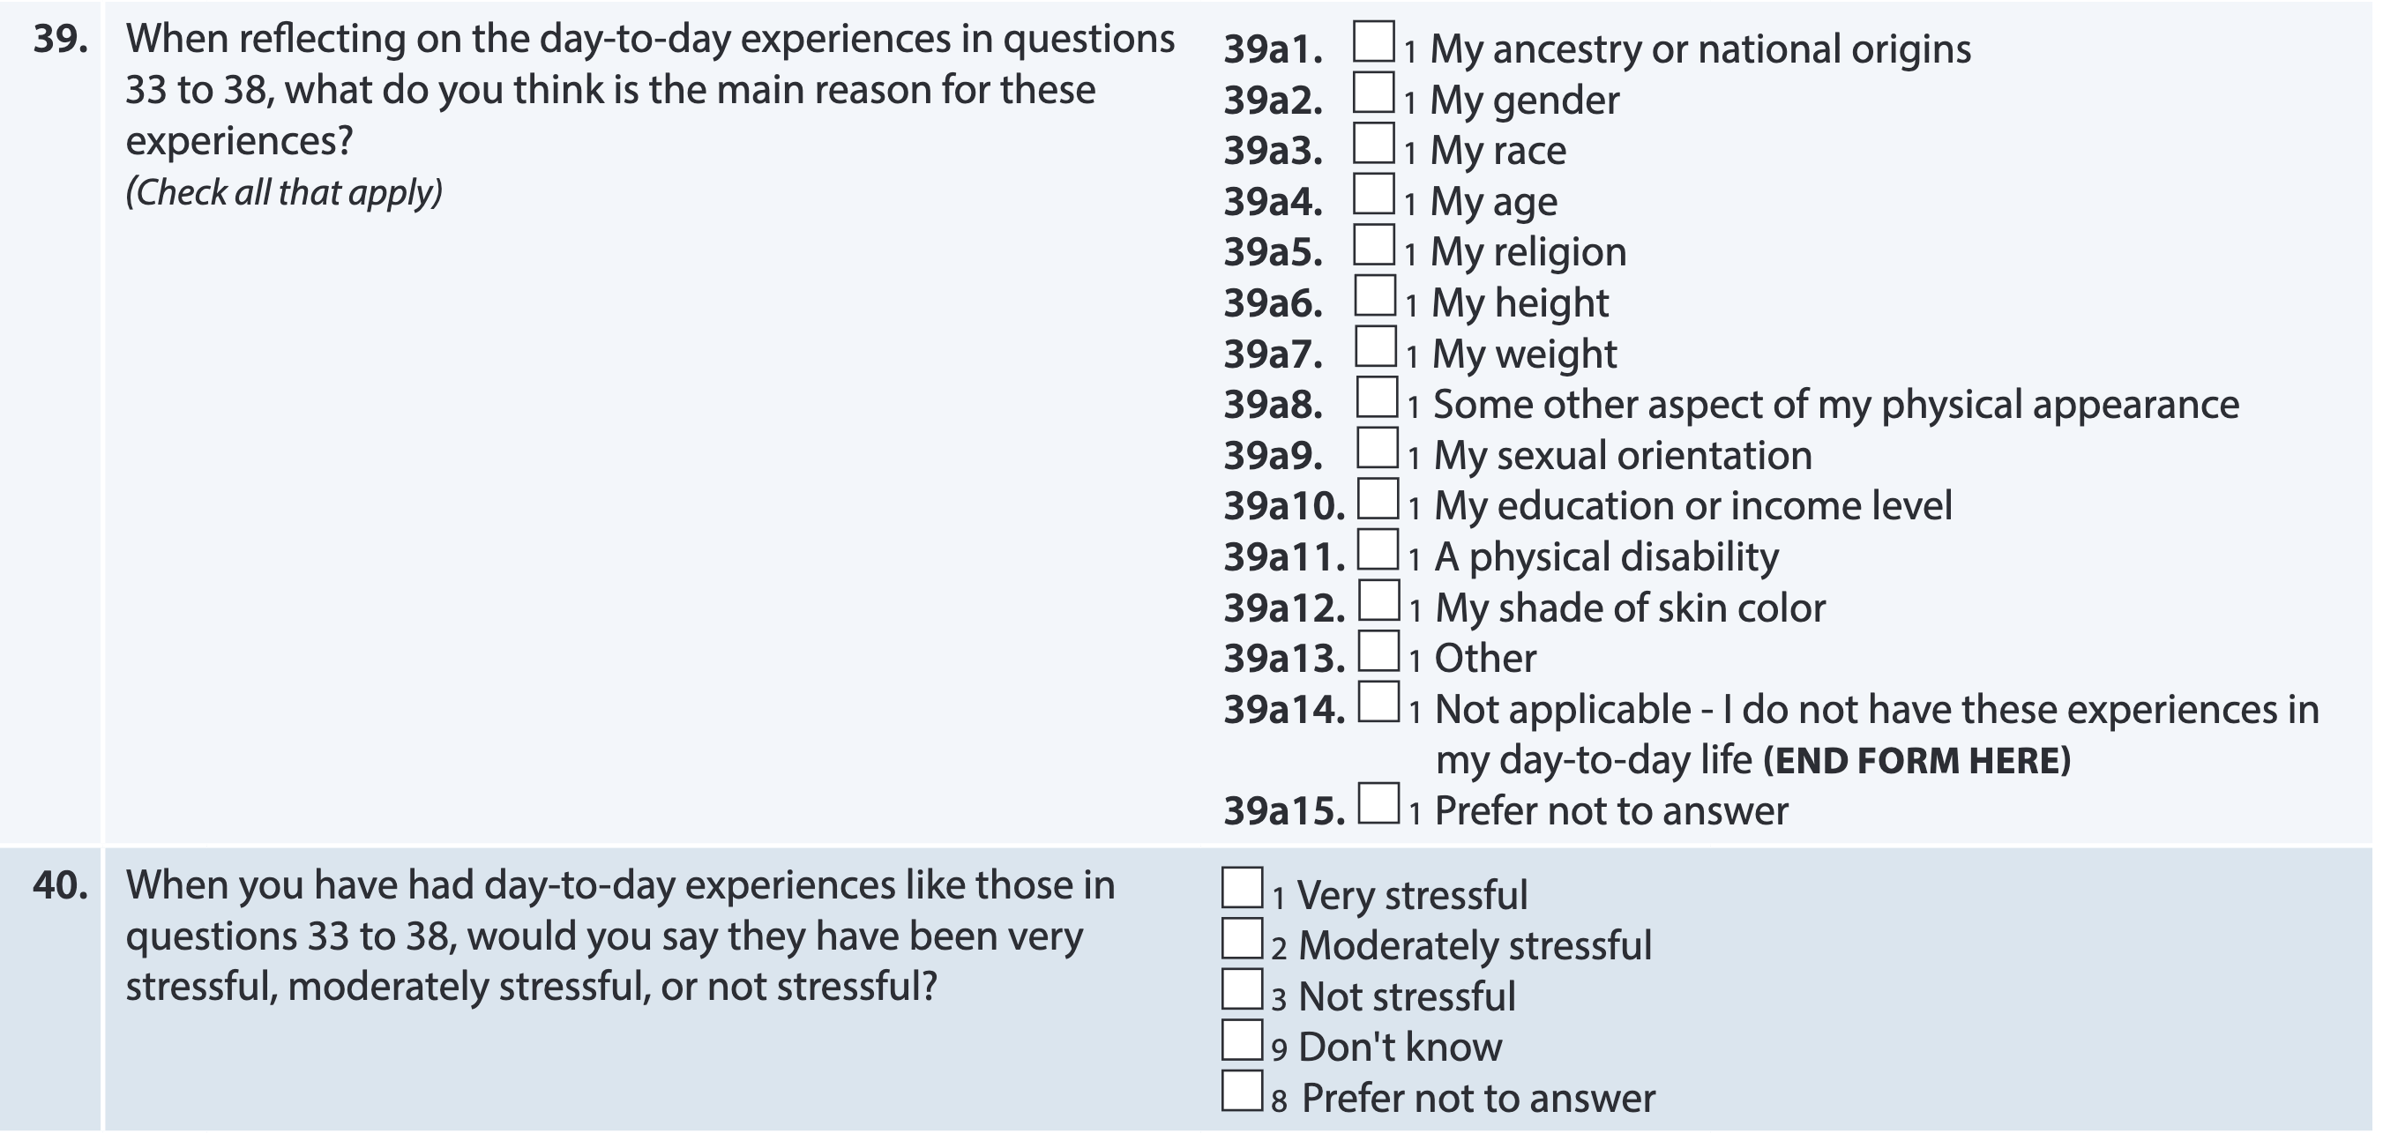
Form A1a: Discrimination Experiences
Everyday Discrimination Index
Widely used index of perceived discrimination
Can sum for an index score
Williams, D. R., Yu, Y., Jackson, J. S., & Anderson, N. B. (1997). Racial Differences in Physical and Mental Health: Socioeconomic Status, Stress, and Discrimination. Journal of Health Psychology , 2 (3), 335-351.
Additional items to assess population-specific effects e.g., empirically observed age, period, cohort effects

Slide 14
Thank you!
Special thanks to SDOH Work group!!
Lisa Barnes, PhD | Megan Zuelsdorff, PhD
Erin Abner, PhD, MPH | Monica Rosselli, PhD
Joyce Balls-Berry, PhD, MPE | Nina Silverberg, PhD
Gregory Jicha, MD, PhD | Shana Stites, PsyD, MS
Patricia Jones, DrPH, MPH | Rachel Whitmer, PhD
Serggio Lanata, MD, MS | Consuelo Wilkins, MD, MSCI
Gladys Maestre, MD, PhD

