Slide 1



Form A4: Medications
Presented by: Teresa Gomez-Isla Massachusetts ADRC
May 14, 2024 – UDSv4 Virtual Clinical Training Workshop

Slide 2
Purpose of Form A4 – standardized medication data collection
Standardized collection of medication data is essential in Alzheimer disease and related dementias (ADRD) clinical research.
The use of a medication coding system reduces error, misspellings, and avoids confusion of generics vs. brand names.
Implementation of a medication coding system that enables Electronic Data Capture (EDC) enhances data quality, efficient data management, and security and accessibility.

Slide 3
Feedback from Centers to proposed changes to Form A4
Most Centers were in favor of transition to electronic data capture (EDC) of medications. A few wondered if both EDC and a paper form can be available. A paper form will still be needed for in person visits where EDC may not be immediately feasible.
Some Centers made suggestions to update list of meds to include other commonly used meds like new anticoagulants, new antidiabetic drugs, other SSRI and dietary supplements, among others.
Several Centers commented on the need to specifically capture newly FDA approved AD-specific treatments, ideally on a separate form.

Slide 4
Proposed changes to Form A4: Medications
Transition to EDC software integrated in RedCap using RxNorm as standardized nomenclature (integrates EPIC and RedCap). Both EDC integrated in RedCap and updated paper form should be available to collect information on meds.
A separate form (A4a: AD-specific treatments) has been created to record treatments known to impact AD/ADRD biomarkers, whether received as part of clinical care or a clinical trial.
If the participant is receiving one of these treatments as part of their clinical care (e.g., aducanumab or lecanemab infusions), the treatment should be included on both A4: Medication form and A4a: AD-specific treatments.

Slide 5
Instructions for Form A4: Medications
This form lists the 100 drugs most commonly reported by participants in the UDS for the years 2015-2023. The drugs are ordered alphabetically by their generic names. If applicable, one or more commercial (brand) names are listed in parentheses.

Slide 6
Instructions for Form A4: Medications

Slide 7
Instructions for Form A4: Medications

Slide 8
Instructions for Form A4: Medications
RxNorm is a naming system for generic and branded drugs that attempts to eliminate confusion by naming drugs in a standardized format. It contains the names of prescription and many over-the-counter drugs available in the U.S. Developed and maintained by the National Library of Medicine (NLM).
If a medication is not listed in Form A4, specify the generic drug or brand name and determine its RxNorm code (RxCUI) by using the RxNav
https://lhncbc.nlm.nih.gov/RxNav/

Slide 9
Concept Unique Identifier (RxCUI)
A key component of RxNorm is the Concept Unique Identifier (RxCUI). The RxCUI is a unique, unambiguous identifier assigned to an individual drug entity and used to relate to all things associated with that drug.
The RxCUI is used to link one entity in RxNorm to every other entity it is related to (name, ingredient, and class). Drug names are linked to the ingredients they contain, and drug ingredients are grouped into drug classes.

Slide 10
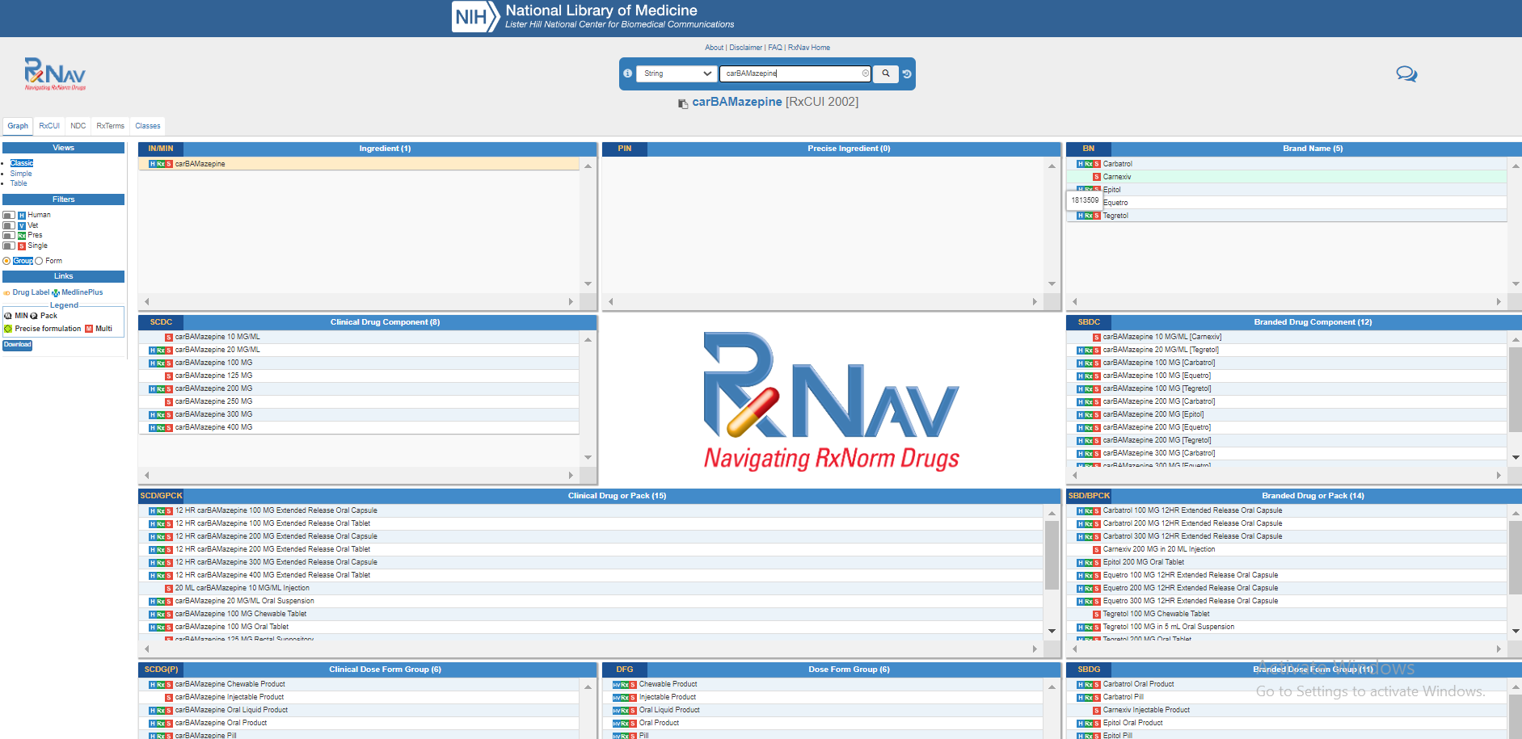

Slide 11
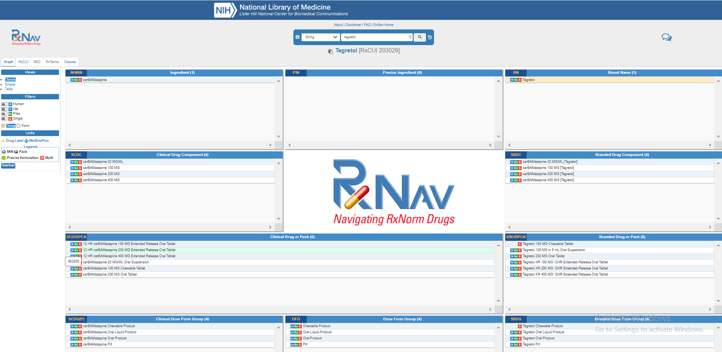

Slide 12
The RedCap A4 form is designed with 3 options:
select from the top 100 list (which is all generic ingredients),
write in the RXCUI for a generic ingredient,
write in the RXCUI for a more specific brand/dosage if that's what the Center wants to capture.
All the above will be accepted

Slide 13
Thank you!
The CTF Clinical Measures and Diagnosis Workgroup
Special thanks to:
Liana Apostolova, Jeff Burns, and the NACC team

Slide 14

Connect
Teresa Gomez-Isla, MD, PhD
tgomezisla@partners.org

