Slide 1
Form A4a:
AD-specific treatments
Presented by: Suzanne E. Schindler, MD, PhD
Washington University Knight ADRC
CTF Clinical Measures and Diagnosis Workgroup
Notes:
As I think everyone appreciates, we are really in a transformative time in the field. Many new treatments are being evaluated in clinical trials. One new treatment is fully FDA-approved and becoming more widely available.
Given that some of these new treatments really have profound effects on biomarkers and may have effects on other measures, how are we to track these participants? Well, UDS 4 has a new form for this. I am going to take you through this form and provide the rationale for what is and is not on the form. I think it’s also important to say from the outset that the field is changing fast, so this form may need to be modified in the not-to-distant future.

Slide 2
Disclosures: Suzanne Schindler, MD, PhD
Research support/grants: Salary and research support is primarily from R01AG070941
Dr. Schindler has previously analyzed biomarker data provided to Washington University by C2N Diagnostics and Roche Diagnostics; no financial incentives or research funding were provided to Dr. Schindler in return.
Stock/Equity: None
Consulting/Employment: Dr. Schindler consulted on biomarker testing for Eisai, Eli Lilly, and Novo Nordisk
Speakers Bureau/Honoraria: Dr. Schindler receives honoraria as a member of the biorepository review committee for the non-profit National Centralized Repository for Alzheimer’s Disease (NCRAD); she has received honoraria for participating in expert panels and reviewing grants from non-profit organizations
Other: Dr. Schindler previously served as a sub-PI for the A4, DIAN-TU, and ENGAGE trials. Dr. Schindler participated in the IDEAS trial.
Notes:
Here are my disclosures. I have served as a consultant on biomarker testing for Eisai, Eli Lilly, and Novo Nordisk.

Slide 3
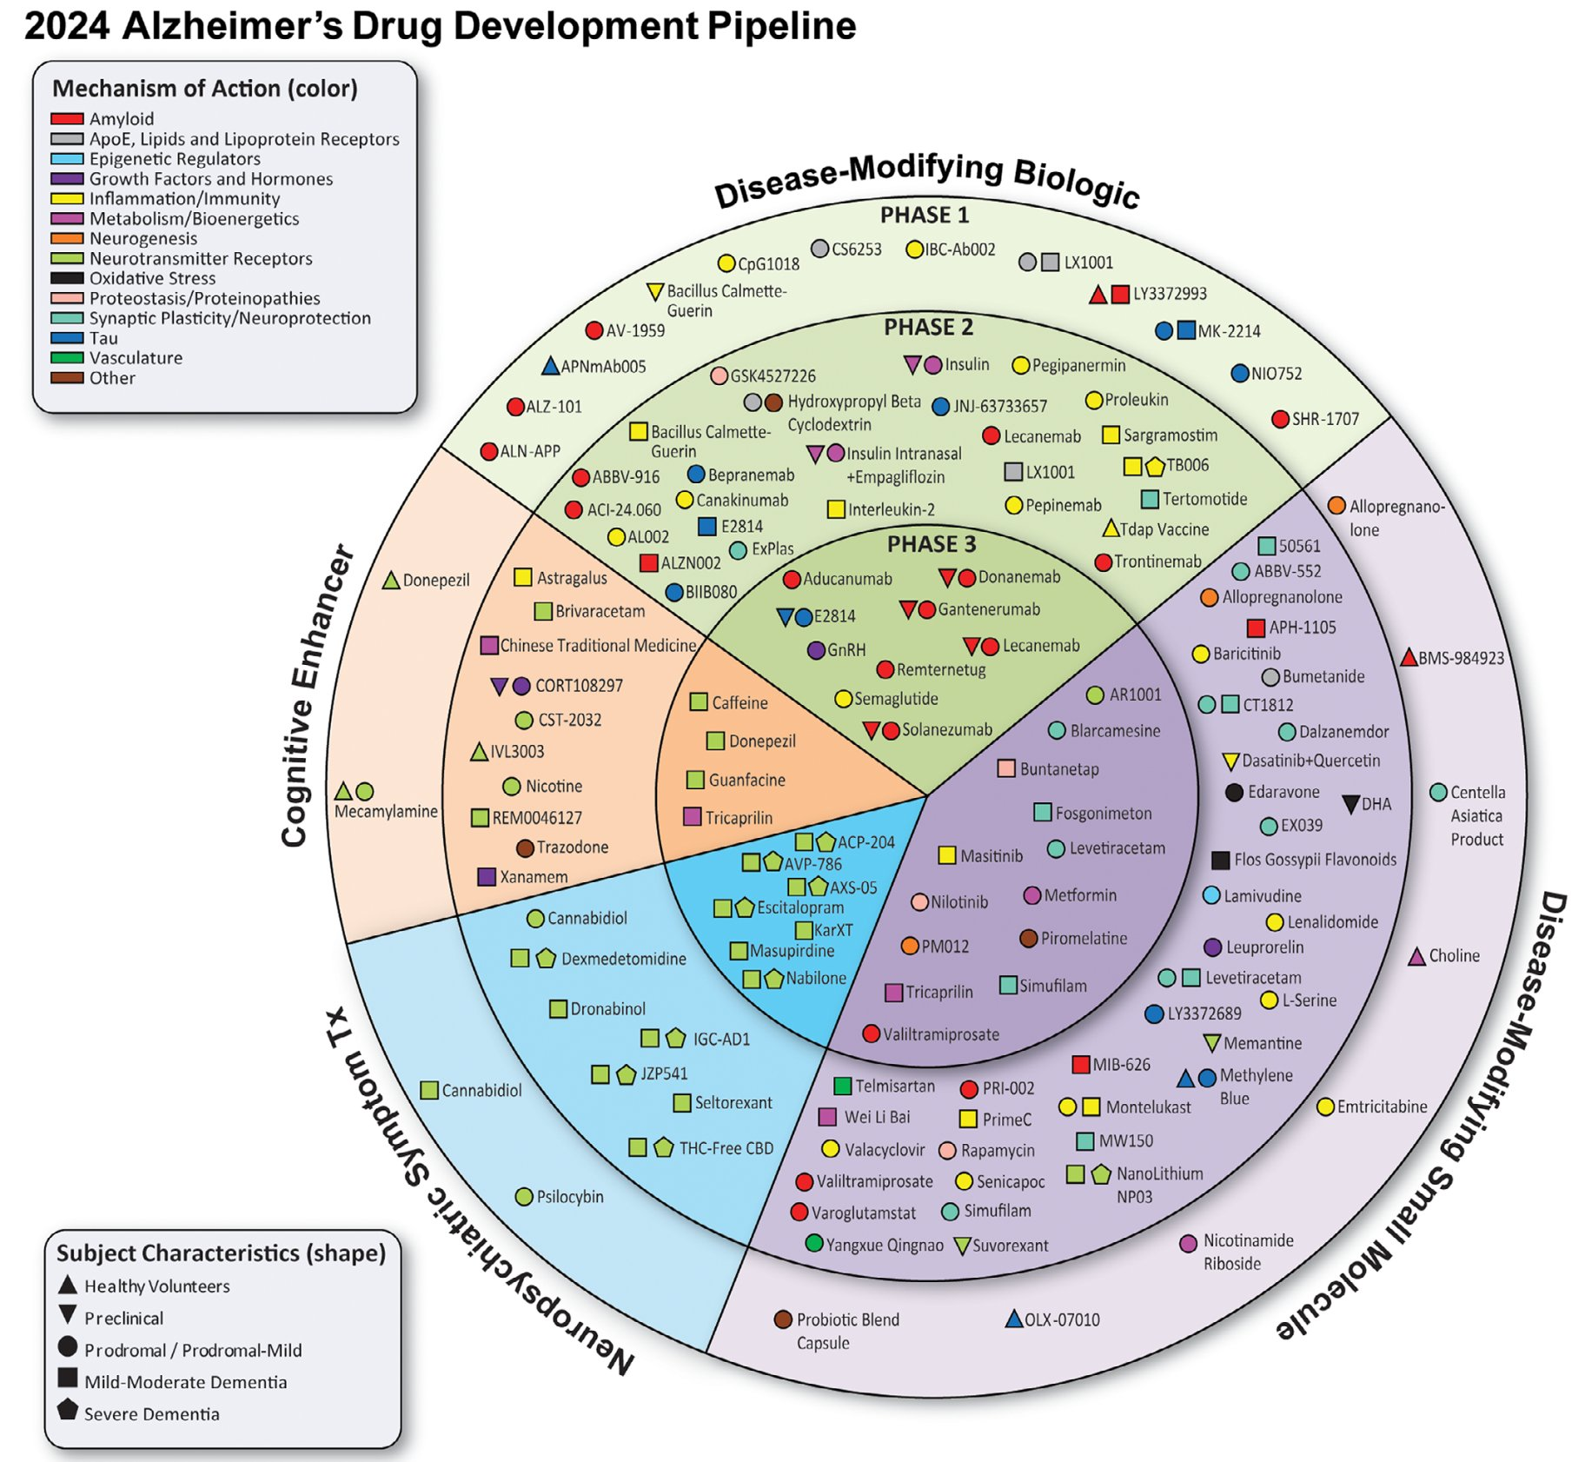
Proliferation of AD-specific treatments
Clinical trials
  In 2024 there were 127 agents in 164 AD clinical trials*
  Current trials require 51,398 participants
  Some treatments have major effects on ADRD biomarkers
  Some of our research participants are receiving these treatments
Clinical care
  Aducanumab received accelerated FDA approved in 2021, but was never widely used
  Lecanemab received full FDA approval on July 6, 2023 and is in clinical use
  Additional AD-specific treatments may be approved within the year
* Cummings et al., Alzheimer’s and Dementia 2024
Notes:
In 2024 there were 127 agents in 164 AD clinical trials*
Current trials require 51,398 participants
Some treatments have major effects on ADRD biomarkers
Some of our research participants are receiving these treatments
Aducanumab received accelerated FDA approved in 2021, but was never widely used
Lecanemab received full FDA approval on July 6, 2023 and is in clinical use
Additional AD-specific treatments may be approved within the year

Slide 4
Why do we need a new form?
Treatments that affect ADRD biomarkers and cognitive performance could confound analyses
There has been no uniform mechanism to identify participants who have received treatments that modify ADRD biomarkers
Limitations of the medication form:
  Records medications at the time of administration, but does not include transient treatment (e.g., 6 months of treatment with lecanemab in-between study visits)
  Not designed to capture participation in clinical trials, in which the treatment may or may not be known (e.g., placebo or active treatment)
  Does not capture any drug effects related to treatments (e.g., ARIA) that can affect ADRD biomarkers (e.g., brain MRI)
AD-specific treatments and trials are rapidly evolving, and a separate form provides increased flexibility for frequent changes
Notes:
So, given that many of our participants may be receiving these treatments through clinical trials or clinical care, we are adding a new form to identify the individuals in our studies who are receiving these treatments. In the past, there was no uniform mechanism to identify which of our participants have received these treatments, and some of the drugs could confound our analyses, particularly of biomarkers.
The Clinical Task Force has many discussion about the best way to do this. An initial suggestion was to add this information to the medication form, but we concluded that the medication form is not the optimal place to record this kind of information. The medication form records the medications that a participant is taking at the time of the clinical assessment, but it can miss transient treatment. So, for example, if a participant received lecanemab for 6 months in-between study visits, this would not be recorded on the medication form. The medication form is also not designed to capture participation in clinical trials, where participants often don’t know whether they are receiving the active treatment or placebo. Additionally, the medication form does not capture any effects related to treatments, such as ARIA, that could affect ADRD biomarkers.
Another reason for having a completely new form is that treatments and trials are rapidly evolving, and a separate form would provide us with increased flexibility to change it as needed.

Slide 5
Process for creating form
Key considerations:
  Burden on participants and centers
  Respecting contracts with pharmaceutical companies
  Alignment with other constructs (e.g., CADRO classification)
  Flexibility
Sub-group of CTF Clinical Measures and Diagnosis Workgroup met and generated a first draft
The CTF Clinical Measures and Diagnosis Workgroup discussed the draft form and made revisions
Feedback was elicited from all the centers (April 22, 2022) and incorporated into a revised draft
The form will primarily be used to identify individuals with data that may be confounded by AD-specific treatments, not to provide detailed information for analysis of AD-specific treatments
Notes:
In creating this form, the Clinical Task Force considered minimizing the burden on participants and centers, respecting contracts with pharmaceutical companies, alignment with other constructs, and flexibility. An initial form was drafted, which was then revised by the entire Clinical Measures and Diagnosis workgroup. Feedback on this revised form was elicited from all the centers in April 2023 and these suggestions were incorporated into a revised draft.
Importantly, the major goal of this form is to identify participants with data that may be confounded by AD-specific treatments. We are not trying to provide comprehensive data to analyze the effects of these drugs—we will leave that to the clinical trials themselves.

Slide 6
Instructions
This form should be used to record treatments known to significantly impact Alzheimer disease and related dementias (ADRD) biomarkers, whether received as part of clinical care or a clinical trial.
If the participant is receiving one of these treatments as part of their clinical care at the time of clinical assessment (e.g., they are receiving aducanumab infusions), the treatment should be included on both this form and the A4 Medication form.
Participation in any ADRD drug trial over an individual's lifetime should be included.
If available, the ClinicalTrials.gov identifier should be entered into the "specific treatment and/or trial" cell. Information on the type of treatment can be found via ClinicalTrials.gov and is summarized in "Alzheimer's disease drug development pipeline."
This form should be completed based on participant interview and/or co-participant report.
For additional clarification and examples, see UDS Coding Guidebook for Initial Visit Packet, Form A4a. Check only one box per question, unless otherwise stated.

Slide 7
Question #1
Has the participant ever been prescribed or been enrolled in a clinical trial of a treatment expected to modify ADRD biomarkers?
Yes/No/Unknown
If no, end of form
Notes:
We formulated three questions to help us identify individuals who have received these treatments and to provide basic information on their exposure.
Question 1 is “Has the participant ever been enrolled in a clinical trial of a treatment expected to modify ADRD biomarkers or been prescribed a clinical treatment expected to modify ADRD biomarkers?” For the vast majority of our participants, the answer will be no and the form will end.

Slide 8
Question #2
Please provide information about the clinical treatment(s) and/or trial(s):
Notes:
However, if the participant has received one of these treatments, the second item will be asked, which provides basic information on their exposure:
Item 2 is “Please provide information about the clinical treatment(s) and/or trial(s):”
Information on the type of treatment, specific treatment if known and can be shared, the start and end date, whether the treatment was provided as part of clinical care and/or a clinical trial, and if the participants know which arm they were in. Again, this is not intended to be comprehensive information to evaluate the treatment, this is basic information to help determine whether the participant’s biomarker data may be confounded by the treatment.

Slide 9
Question #3
Has the participant ever experienced amyloid related imaging abnormalities-edema (ARIA-E), amyloid related imaging abnormalities-hemorrhage (ARIA-H), or other major adverse events associated with treatments expected to modify ADRD biomarkers?
  Yes/No/Unknown
What major adverse events associated with treatments expected to modify ADRD biomarkers did they experience? (check all that apply)
  Amyloid related imaging abnormalities-edema (ARIA-E)
  Amyloid related imaging abnormalities-hemorrhage (ARIA-H)
  Other issues (free text)
Notes:
The last question is “Has the participant ever experienced amyloid related imaging abnormalities-edema (ARIA-E), amyloid related imaging abnormalities-hemorrhage (ARIA-H), or other major adverse events associated with treatments expected to modify ADRD biomarkers?”
This information may be helpful to neuroimagers trying to interpret MRI findings. This is not intended to be a detailed dataset for the evaluation of adverse events.

Slide 10
Future of the form
The major use will be to identify individuals who have received treatments that confound biomarker analyses
It is likely that the form will need to be revised often, especially if new drugs are approved
If a larger proportion of participants start taking AD-specific treatments, a greater level of detail (e.g., doses, more details about adverse effects) may be appropriate to add
Notes:
The major use will be to identify individuals who have received treatments that confound biomarker analyses
It is likely that the form will need to be revised often, especially if new drugs are approved
If a larger proportion of participants start taking AD-specific treatments, a greater level of detail (e.g., doses, more details about adverse effects) may be appropriate to add

Slide 11
Thank you!
The CTF Clinical Measures and Diagnosis Workgroup
Special thanks to:
Greg Jicha, Jeff Burns, Teresa Gomez-Isla, Nina Silverberg
Notes:
I’d like to thank the members of the Clinical Task Force Clinical Measures and Diagnosis Workgroup, especially Greg Jicha, Jeff Burns, Teresa Gomez-Isla, and Nina Silverberg.

