Slide 1



A5-D2 Participant Health History / Clinician-assessed Medical Conditions
Presented by: Aimee Pierce, M.D.
May 14, 2024 – UDSv4 Virtual Clinical Training Workshop

Slide 2
Participant Health History /
Clinician-assessed Medical Conditions
From UDSv3, A5 Health History and D2 Clinician-assessed Medical Conditions have been combined into a single form: UDSv4 A5-D2 Participant Health History / Clinician-assessed Medical Conditions
A5-D2 is to be completed by the clinician or ADRC staff based on the medical history interview with the participant and co-participant, as well as review of any medical records that are available.

Slide 3
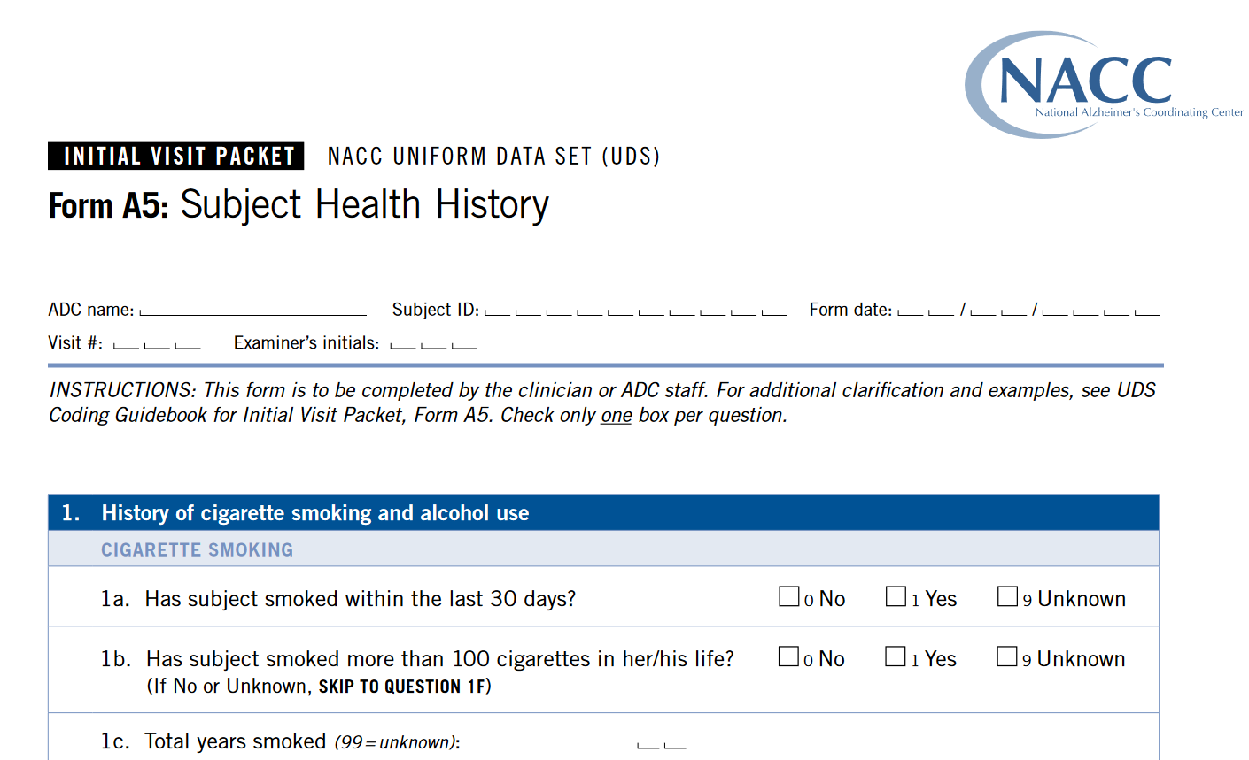
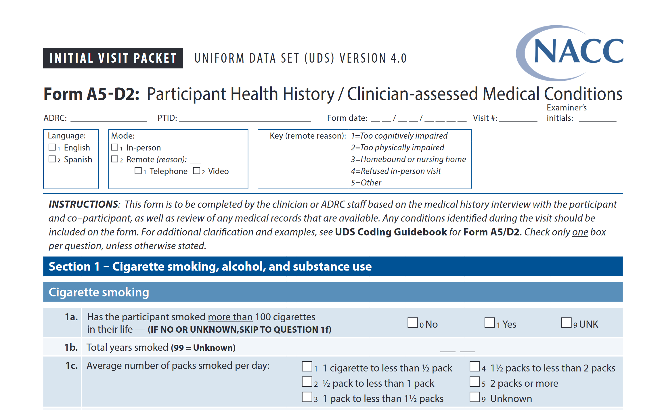
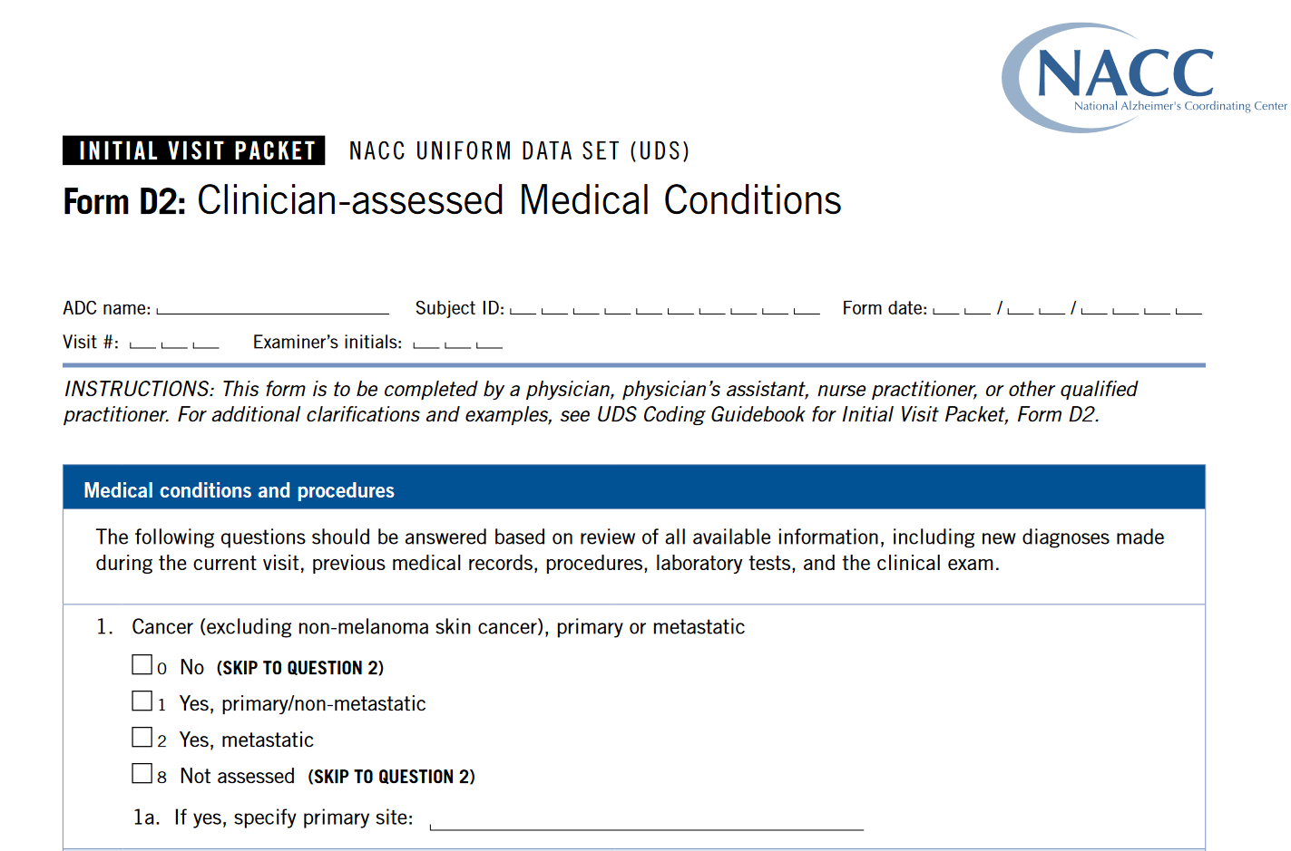
Form A5 and D2 combined into single form A5-D2 in UDSv4

Slide 4






Data sources

Slide 5

What’s new?
Much of the form will be familiar, with more detailed questions about specific conditions as well as some new conditions added.
More detailed information about TBI, including risk factors, will be collected.
More detailed information about cancer history
and treatment will be collected.
Psychiatric conditions information will be based
on DSM-5-TR criteria.
New information will be collected about
menstrual and reproductive health.

Slide 6
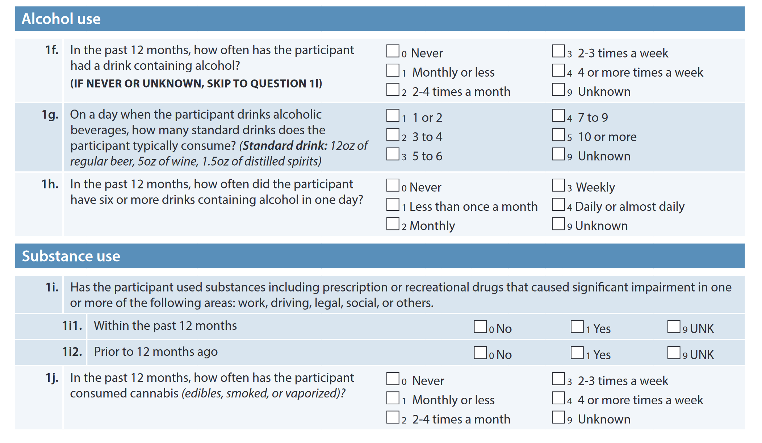



1f., 1h., 1j. Alcohol and substance use

Slide 7
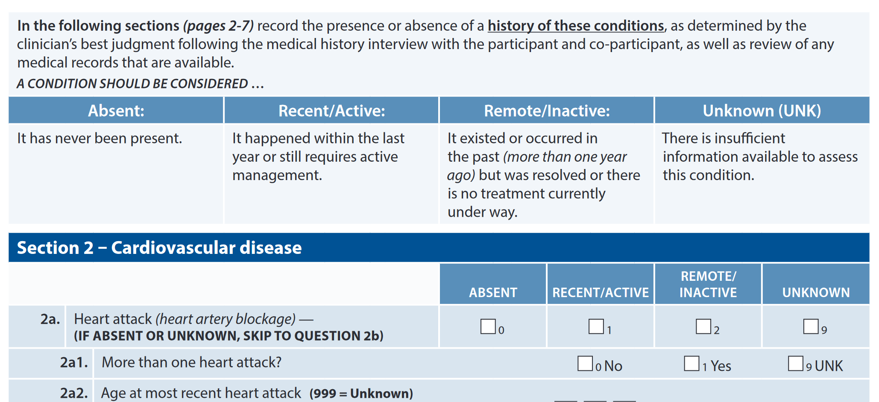
Definitions of Absent, Recent/Active, and Remote/Inactive

Slide 8
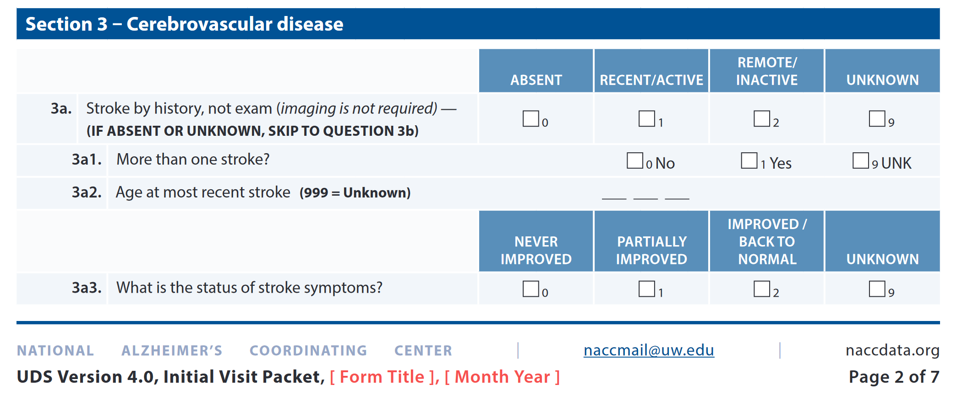
3a3. Stroke recovery

Slide 9
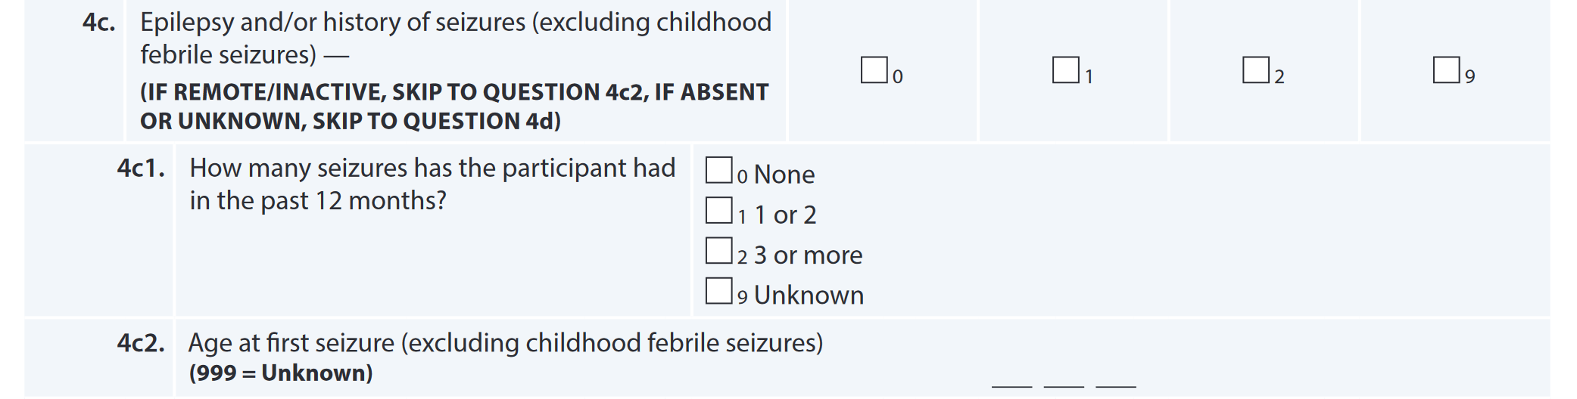


4c1. and 4c2. Details about seizure history

Slide 10
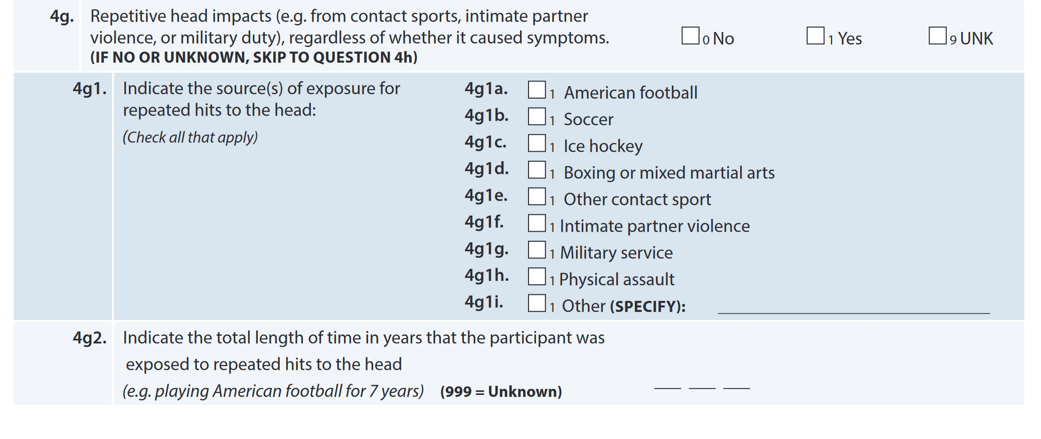
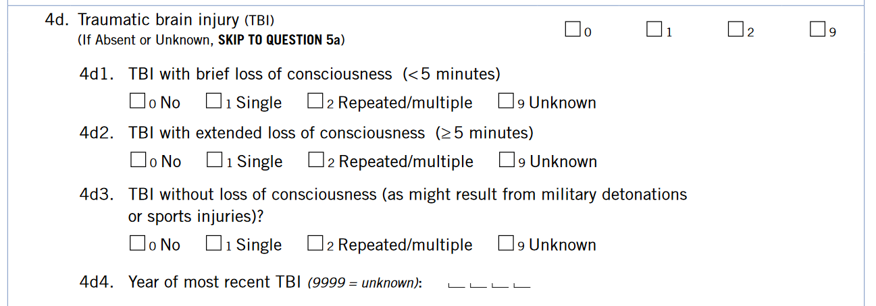
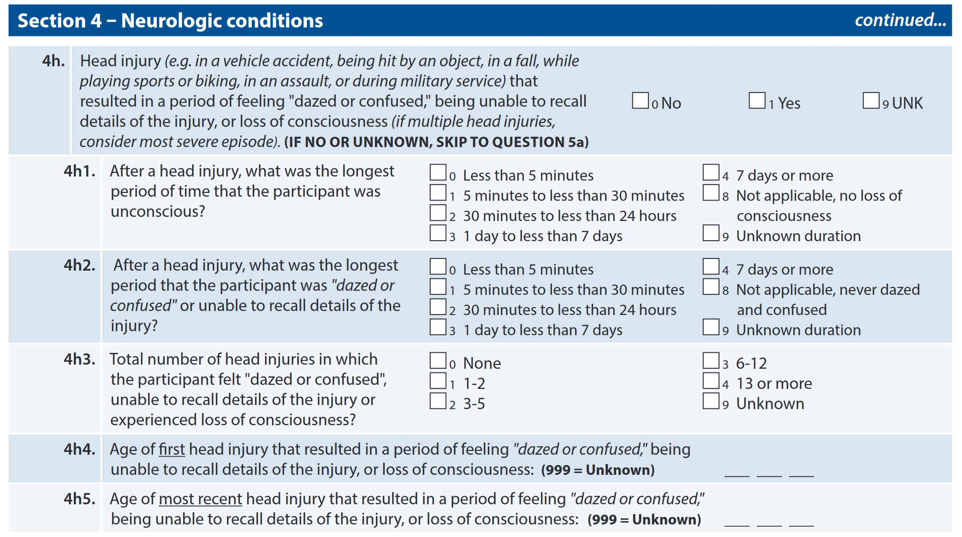
4g. and 4h. Repetitive head impacts and TBI

Slide 11
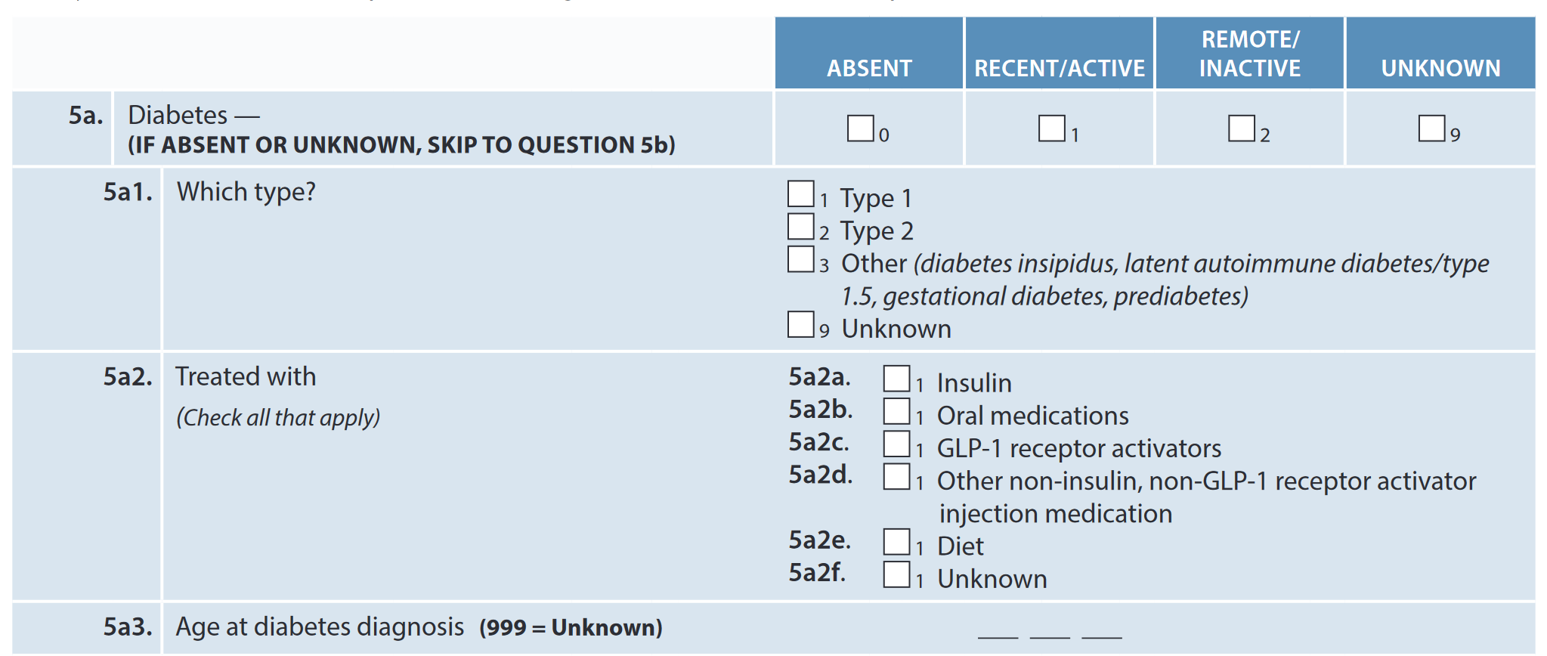


5a. Diabetes

Slide 12
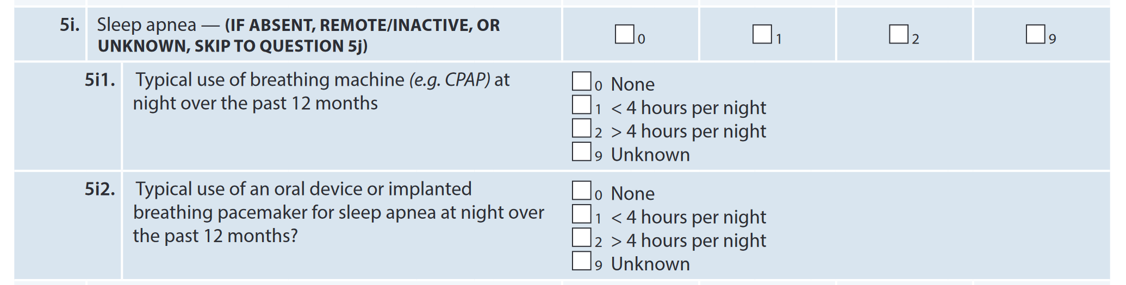



5i. Sleep apnea - treatment

Slide 13
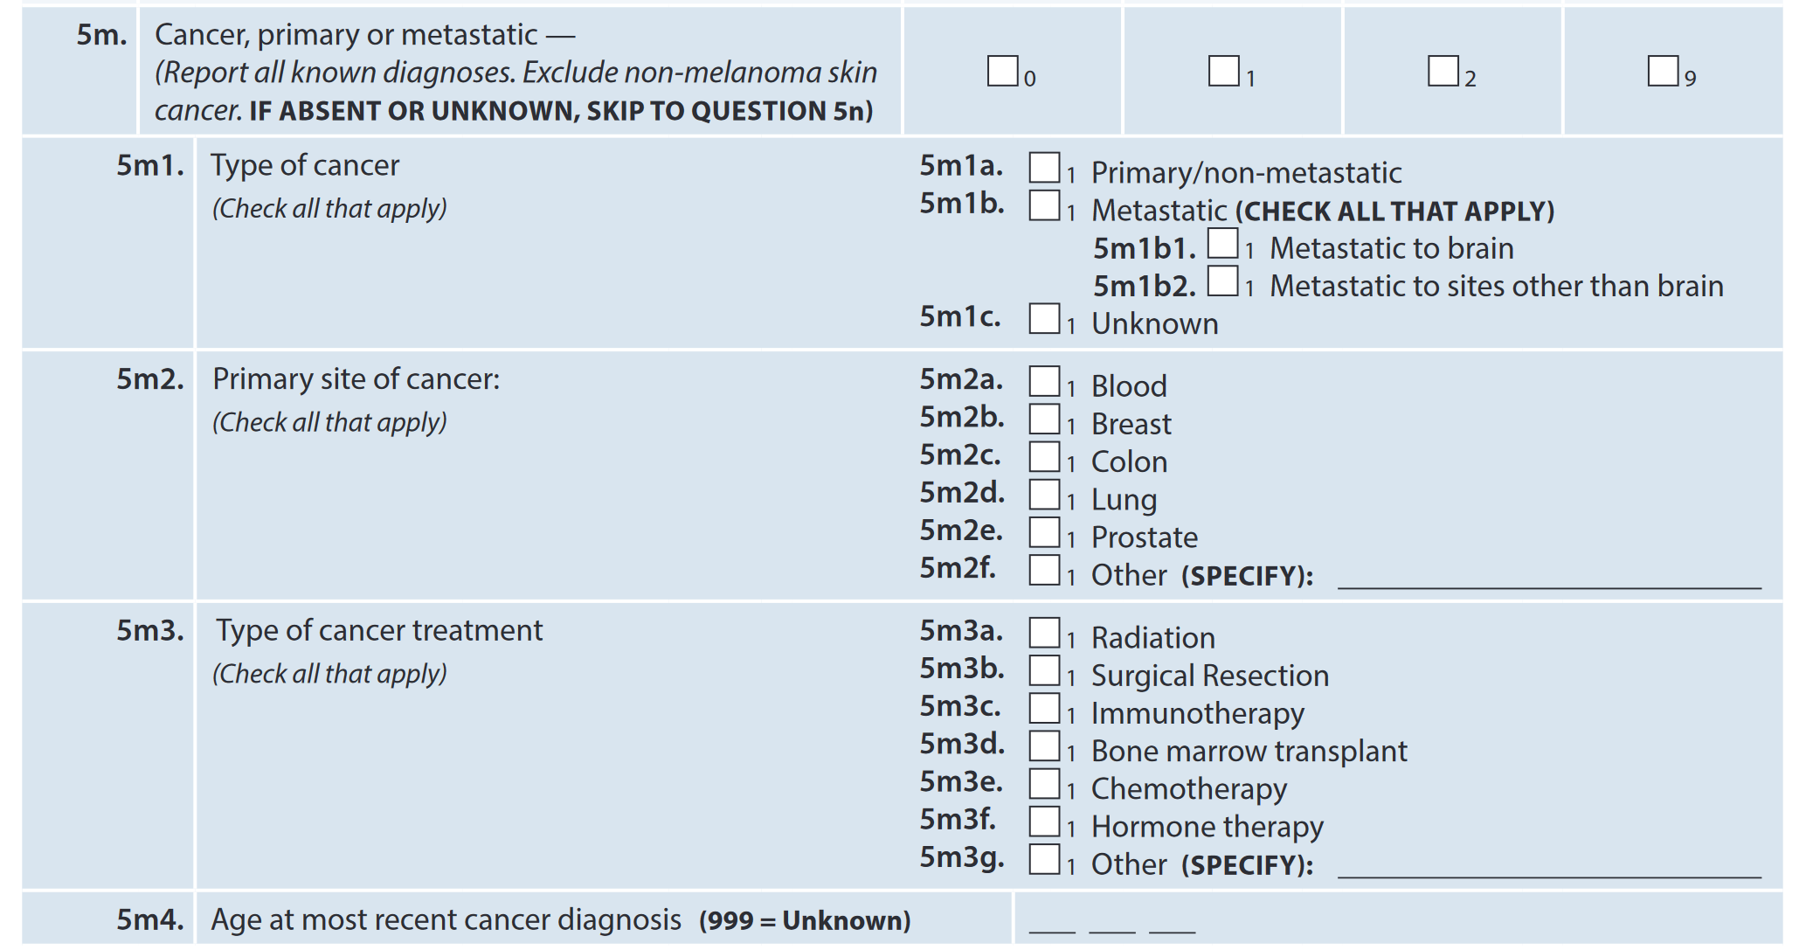


5m. Cancer history and treatment

Slide 14
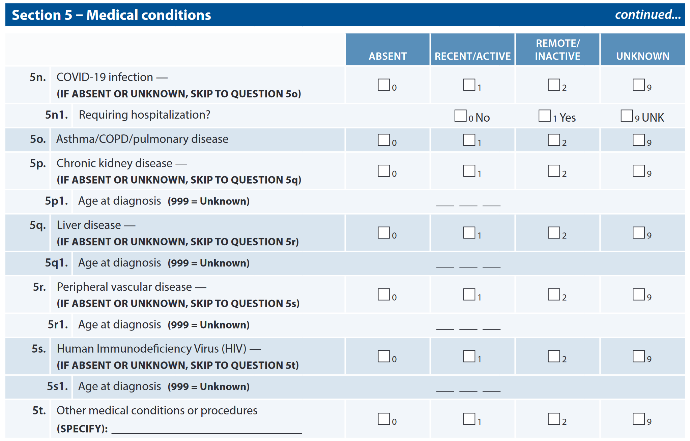

Section 5 – Broader and deeper coverage of medical conditions

Slide 15
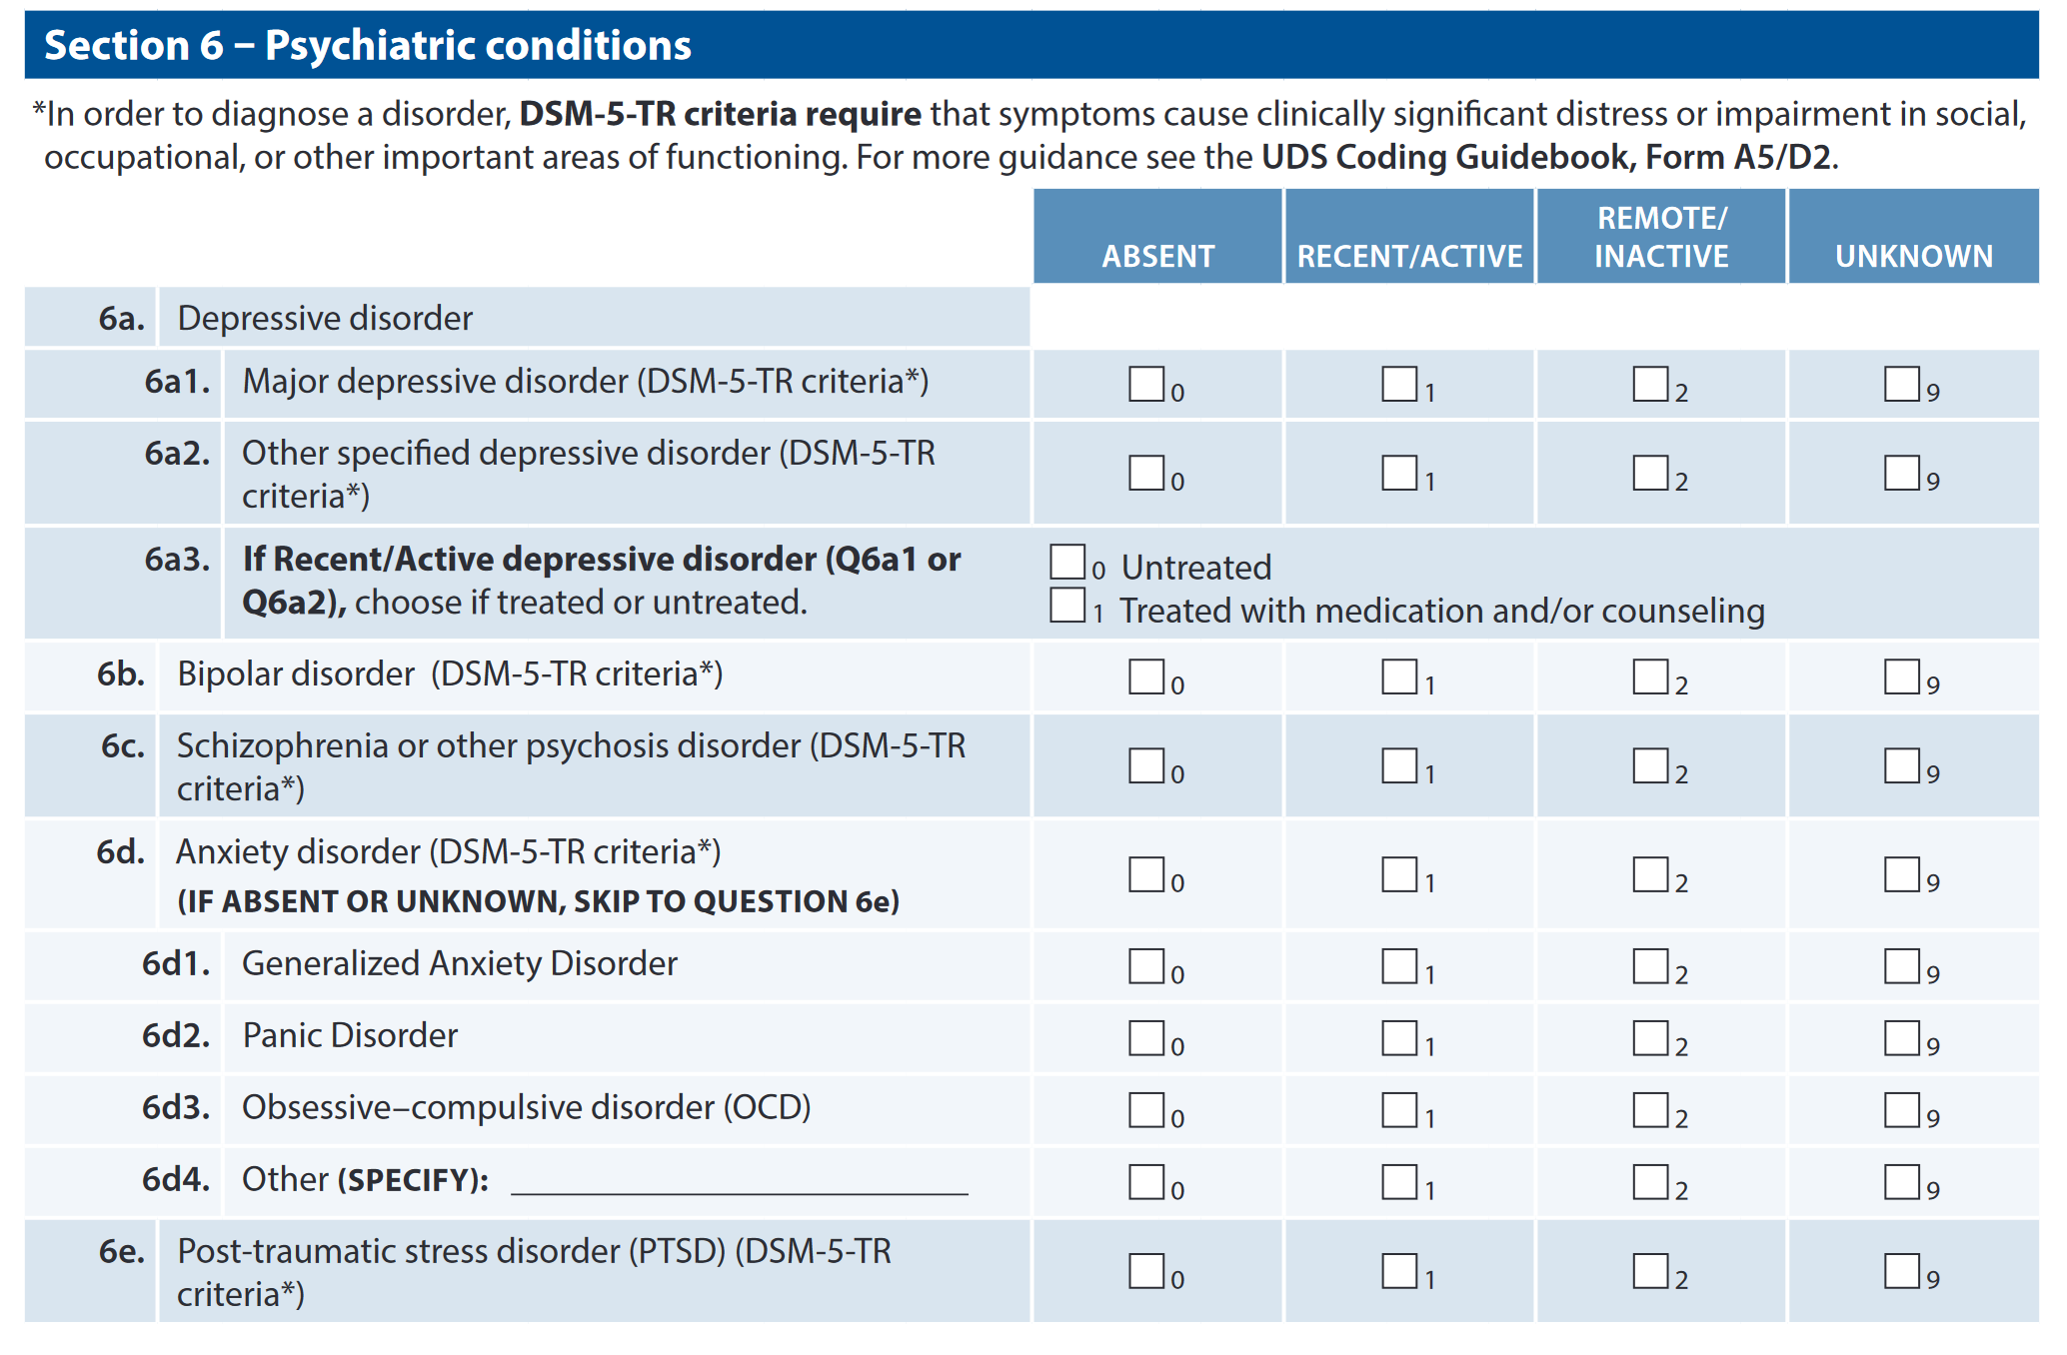

Section 6 – Psychiatric conditions

Slide 16
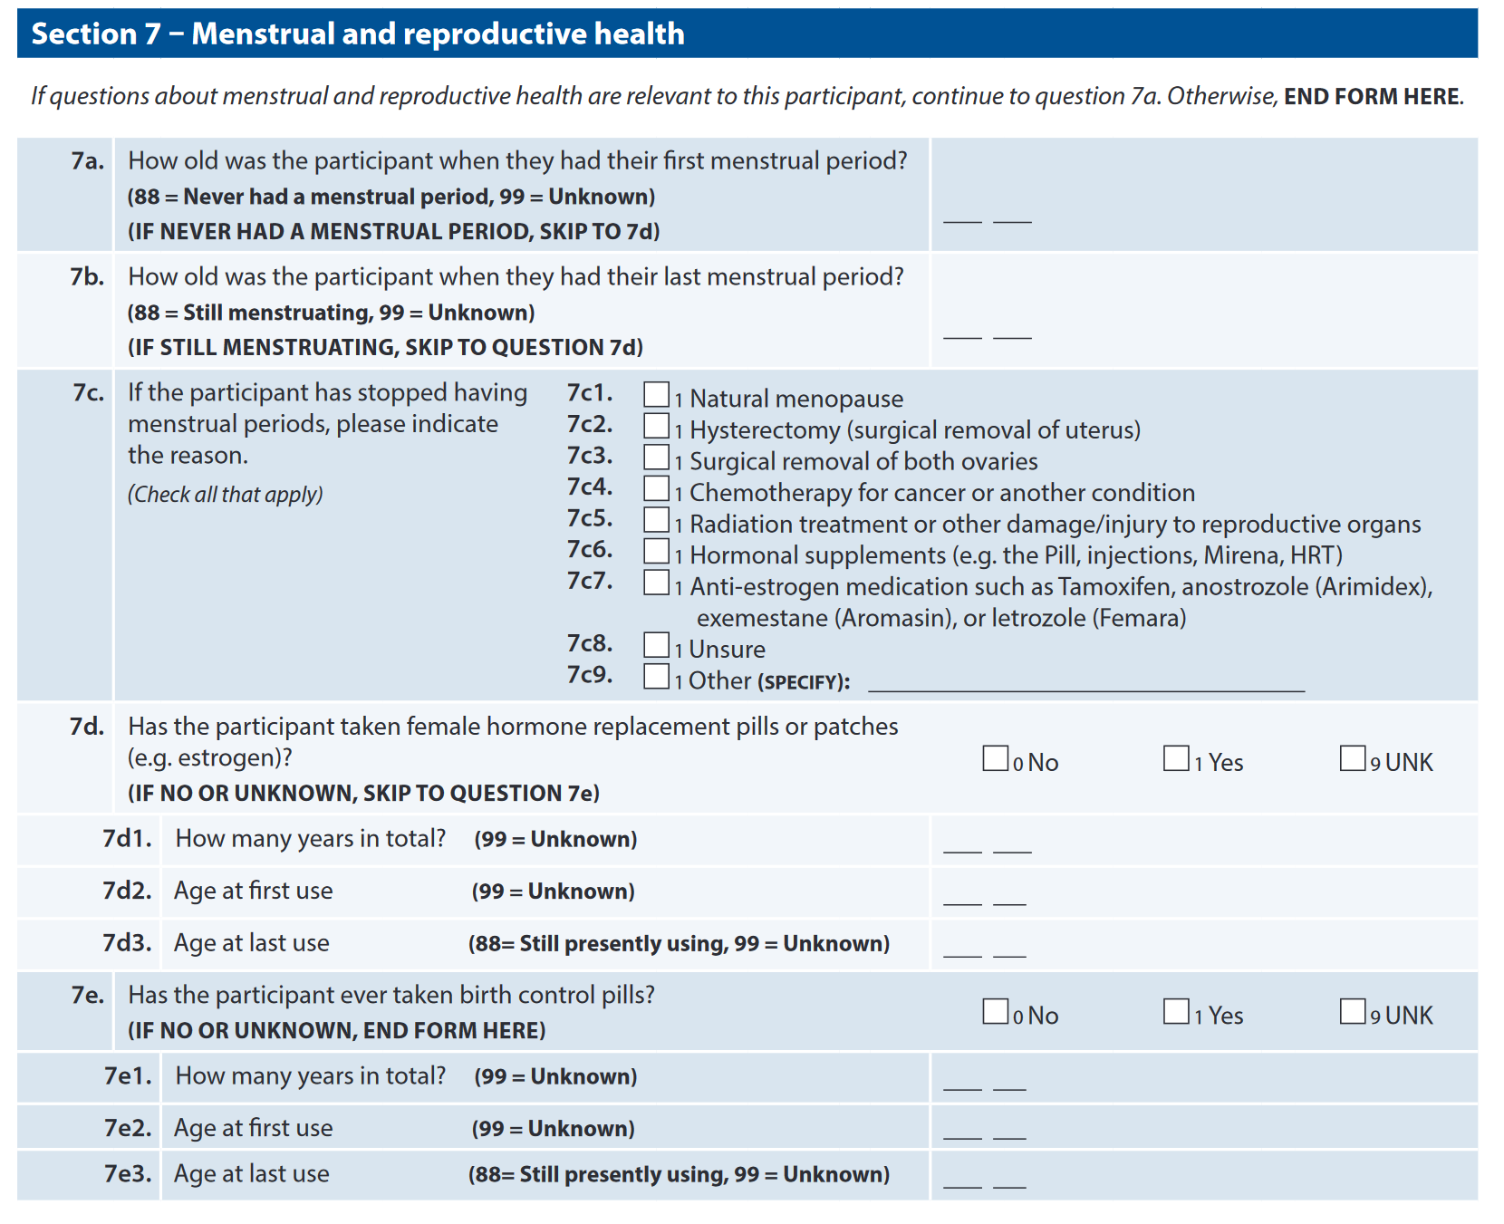
Section 7 – menstrual and reproductive health - New

Slide 17
Summary
From UDSv3, A5 Health History and D2 Clinician-assessed Medical Conditions have been combined into a single form: UDSv4 A5-D2 Participant Health History / Clinician-assessed Medical Conditions
A5-D2 is to be completed by the clinician or ADRC staff based on the medical history interview with the participant and co-participant, as well as review of any medical records that are available.
Broader and deeper coverage of health history including topics in neurologic, medical, psychiatric, and reproductive health

Slide 18
Thank you!

Slide 19

Connect
Aimee Pierce, M.D.
piercea@ohsu.edu

