Slide 1
Form B3: Unified Parkinson’s Disease Rating Scale (UPDRS) – Motor Exam
Presented by: Brad Boeve, MD
May 14, 2024 – UDSv4 Virtual Clinical Training Workshop

Slide 2
Form B3: UPDRS – Motor Exam
Purpose
determine the degree of parkinsonism on any visit
track the degree of parkinsonism over time
Definition (loosely defined for NACC purposes)
Bradykinesia
Rigidity
Tremor
Other features suggesting extrapyramidal dysfunction
The UPDRS is not intended to establish the presence or absence of parkinsonism per se

Slide 3
Form B3: UPDRS – Motor Exam
Instructions
This form is to be completed by the clinician or other trained health professional
Clinician should record results as observed regardless of whether there are non-parkinsonian contributions or explanations for the findings
For additional clarification and scoring instructions, see UDS Coding Guidebook for Form B3. For video-recorded examples of administration, see Perlmutter JS. Assessment of Parkinson disease manifestations. Curr Protoc Neurosci. 2009 Oct; Chapter 10: Unit10.1. doi: 10.1002/0471142301.ns1001s49.

Slide 4
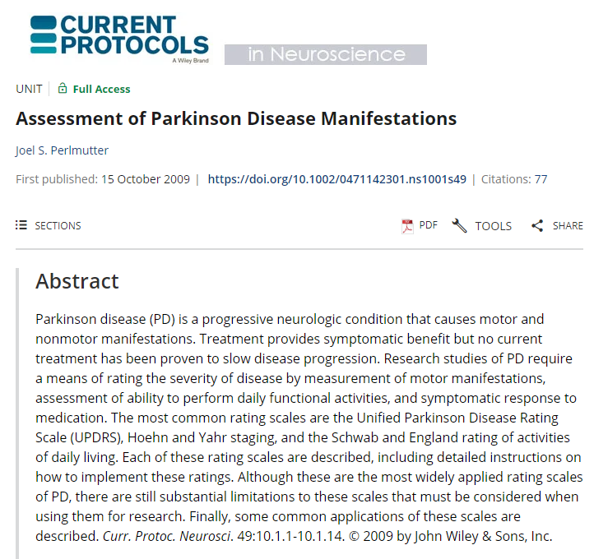
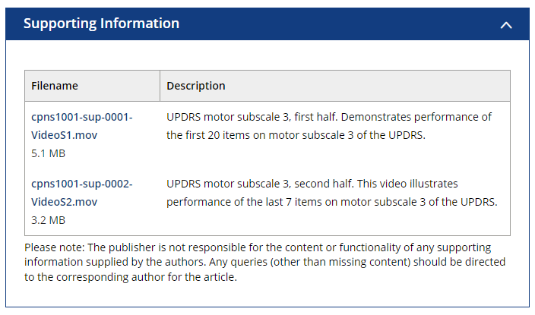
Form B3: UPDRS – Motor Exam
https://currentprotocols.onlinelibrary.wiley.com/doi/10.1002/0471142301.ns1001s49

Slide 5
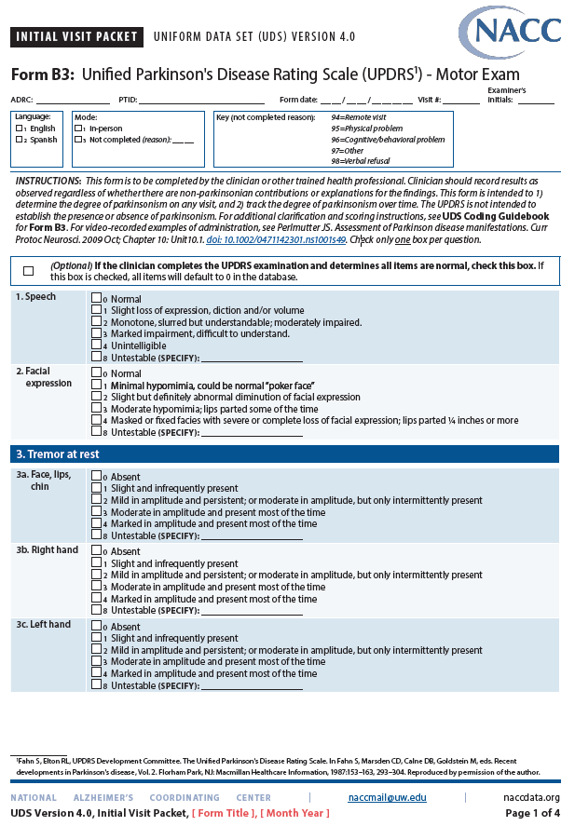
Form B3: UPDRS – Motor Exam

Slide 6
Form B3: UPDRS – Motor Exam
Mode and Key
Instructions – as reviewed in previous slides
Click only one box per question
Gateway question:
Click if full UPDRS motor exam performed and all items are normal – all fields default to 0

Slide 7
Form B3: UPDRS – Motor Exam
Note how to code if any item is “untestable” (i.e., amputation, sequelae from stroke, cast due to recent limb fracture, etc.)

Slide 8
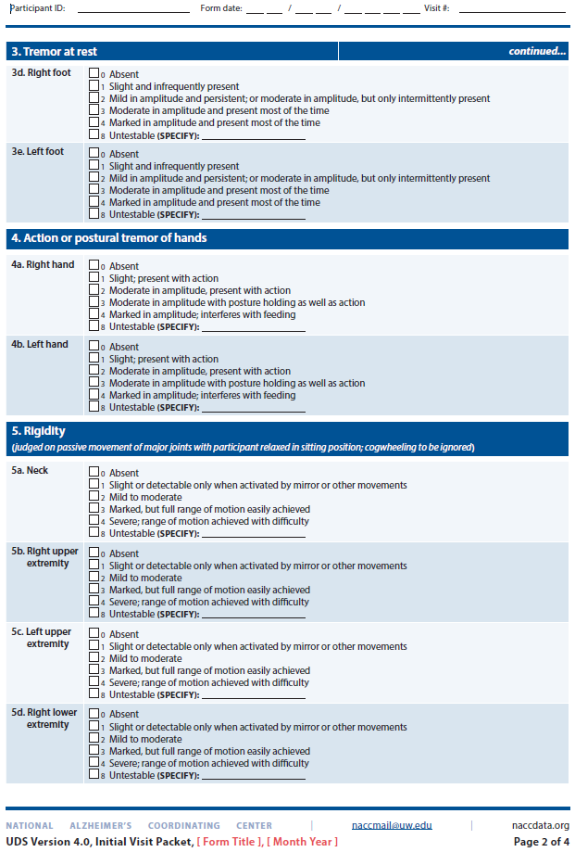
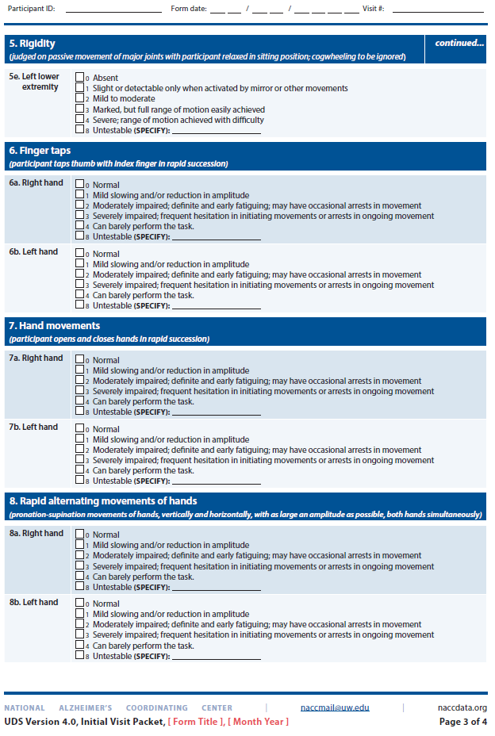
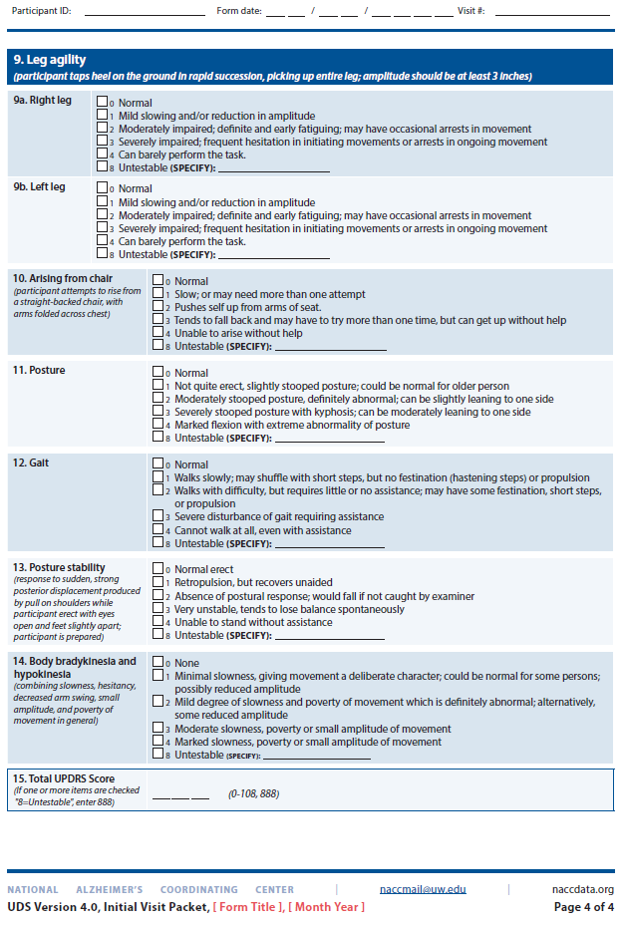
Form B3: UPDRS – Motor Exam

Slide 9
Form B3: UPDRS – Motor Exam
Note how to use 888 code if any item is “untestable”

Slide 10
Form B3: UPDRS – Motor Exam
Key Points – 1
Traditional UPDRS was used in UDSv2, dropped for UDSv3, but desired for UDSv4 to capture elements of parkinsonism
MDS-UPDRS was considered for UDSv4, but due to expense of use, copyright concerns, certification requirement, and cost of certification, the “traditional” UPDRS was viewed as the better option
Sites can obviously use the MDS-UPDRS, and how the Form B3 UPDRS will be completed is up to the site

Slide 11
Form B3: UPDRS – Motor Exam
Key Points – 2
Motor exam is expected on all ADRC participants when evaluated in-person; usually completed in <5 minutes
Completion of B3 form should take <2 minutes
No formal certification required, but each site should determine mechanisms for sufficient training of staff, and for promoting consistency and reliability of recorded data

Slide 12
Thank you!

Slide 13
Connect
Brad Boeve, MD
bboeve@mayo.edu

