Slide 1
Form D1a: Clinical Syndrome
Presented by: Jeffrey Burns, MD; Andy Saykin, PsyD; Kostas Lyketsos, MD, MHS; and Greg Jicha, MD, PhD
May 14, 2024 – UDSv4 Virtual Clinical Training Workshop

Slide 2
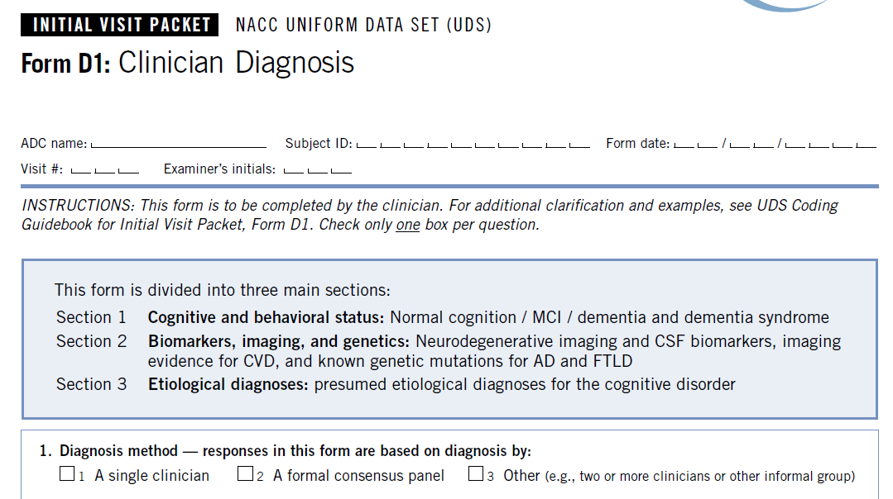
Old D1: Clinician Diagnosis → New D1a and D1b

Slide 3
D1a Organization
Level of Impairment
Unimpaired
Subjective Cognitive Decline
Dementia
MCI
“Cognitive Impairment, Not MCI/dementia”
Mild Behavioral Impairment (MBI)
Clinical Syndrome
Amnestic, dysexecutive, Visual, PPA, Lewy body syndrome, FTD syndrome, others (PSP, TES, CBS)
Contributing Conditions
Psychiatric (depression, anxiety, etc)
TBI, epilepsy, NPH, etc

Slide 4
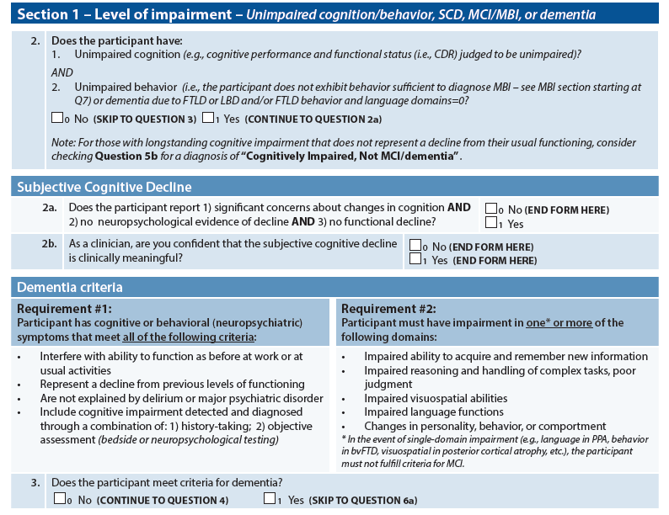
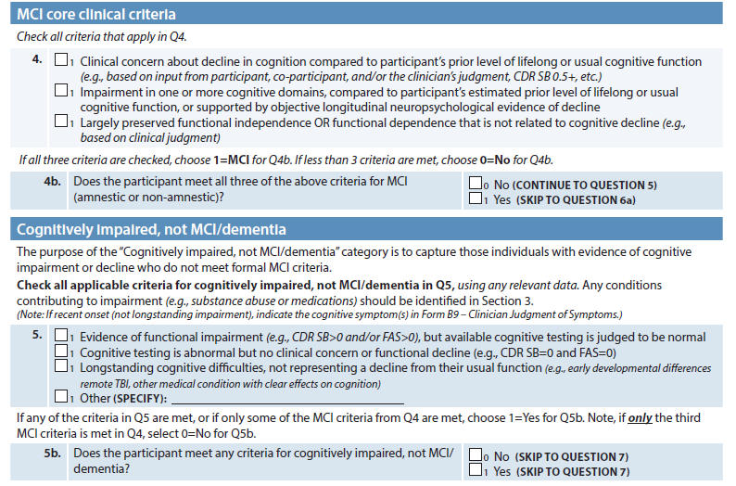
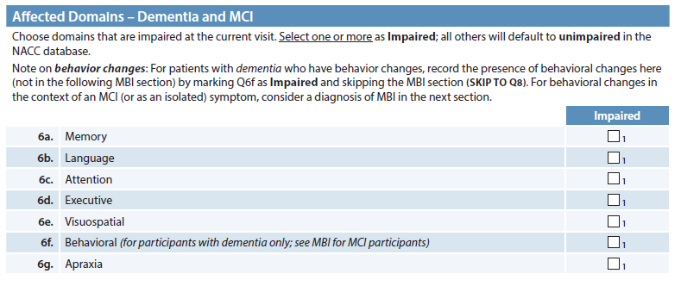
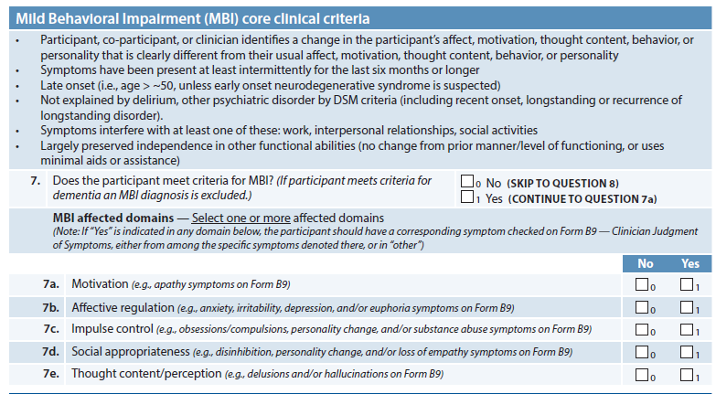
Section 1: Level of Impairment

Slide 5
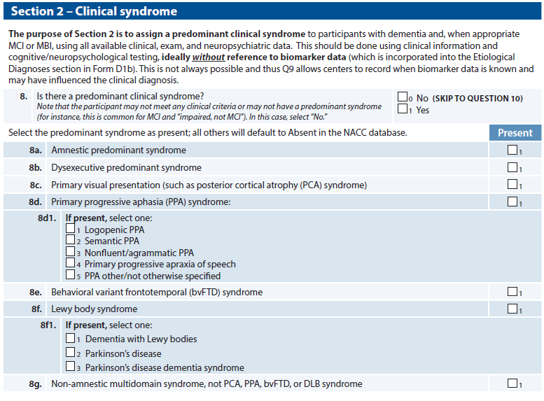
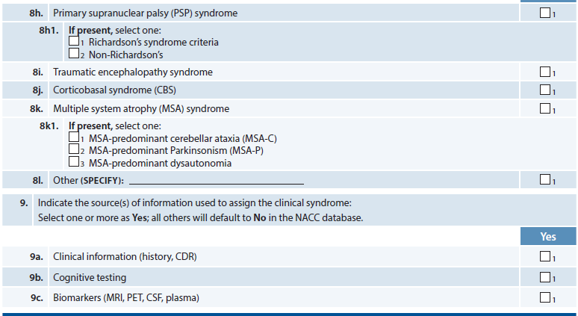
Section 2: Clinical Syndrome

Slide 6
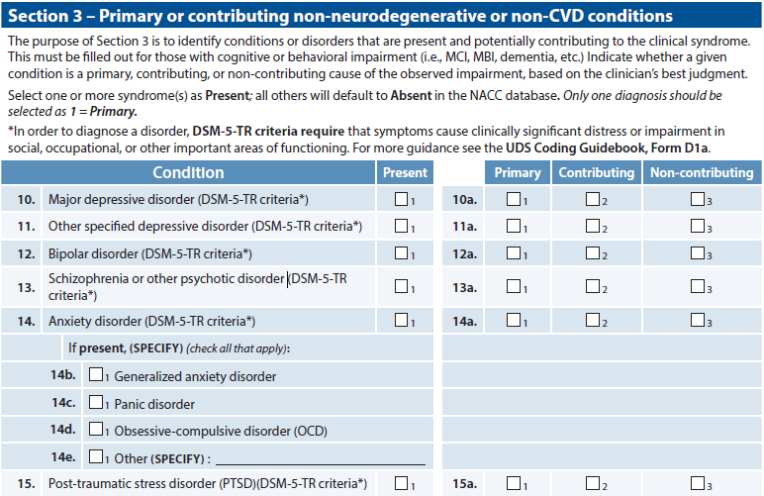
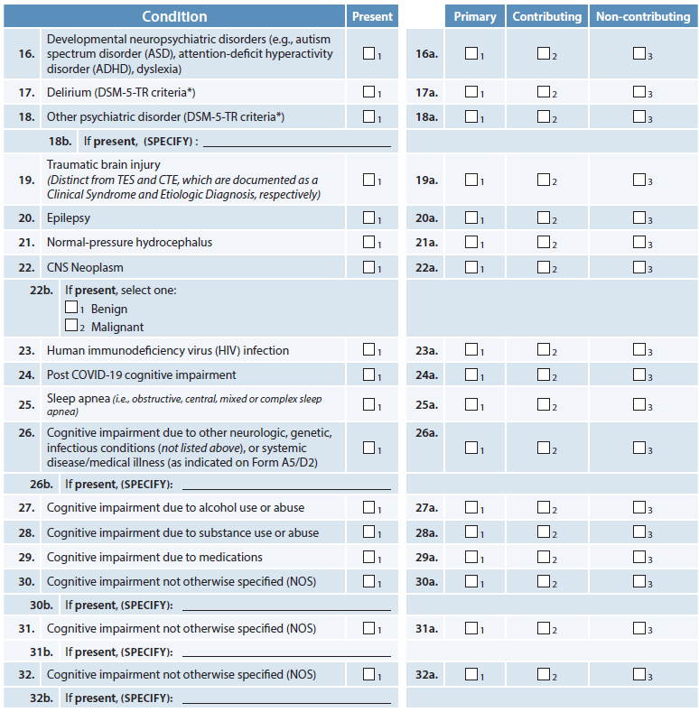
Section 3: Contributing Conditions

Slide 7
What’s new?
Splitting D1 into 2 forms
D1a: Clinical Syndrome
D1b: Etiological Diagnosis and Biomarker Support
Added
Subjective Cognitive Decline (SCD)
Mild Behavioral Impairment (MBI)
Additional Criteria
MCI criteria
“Cognitive Impairment, Not MCI/Dementia”

Slide 8
Section 1: Level of Impairment

Slide 9
Section 1: Level of Impairment

Slide 10
Section 1: Level of Impairment

Slide 11
Section 1: Level of Impairment

Slide 12
Section 1: Level of Impairment

Slide 13
Section 1: Level of Impairment

Slide 14
Section 1: Level of Impairment

Slide 15
Section 1: Level of Impairment

Slide 16
Section 1: Level of Impairment

Slide 17
Section 1: Level of Impairment

Slide 18
Section 1: Level of Impairment

Slide 19
Section 1: Level of Impairment

Slide 20
Section 1: Level of Impairment

Slide 21
Section 1: Level of Impairment

Slide 22
Section 1: Level of Impairment

Slide 23
Section 2: Clinical Syndrome

Slide 24
Section 2: Clinical Syndrome

Slide 25
Section 2: Clinical Syndrome

Slide 26
Section 2: Clinical Syndrome

Slide 27
Section 3: Contributing Conditions

Slide 28
Section 3: Contributing Conditions

Slide 29
Section 3: Contributing Conditions

Slide 30
Section 3: Contributing Conditions

Slide 31
D1a Subjective Cognitive Decline (SCD) and Self Reported Symptom Items
Andrew Saykin, PsyD
For the CTF
May 14, 2024 – UDSv4 Virtual Clinical Training Workshop

Slide 32
Subjective Symptoms and SCD in UDS4
Prior to UDS4 symptoms of subjective cognitive decline (SCD) were inconsistently reported though there is increasing research interest in this area
The cognitively unimpaired group, defined by psychometric criteria, includes many participants with self and/or co-participant reported decline
After consideration of current concepts, definitions and existing measures, it was decided to include a small set of memory decline items in the core UDS4 and to provide a recommendation for centers wishing to assess subjective symptoms in greater detail, including other domains

Slide 33
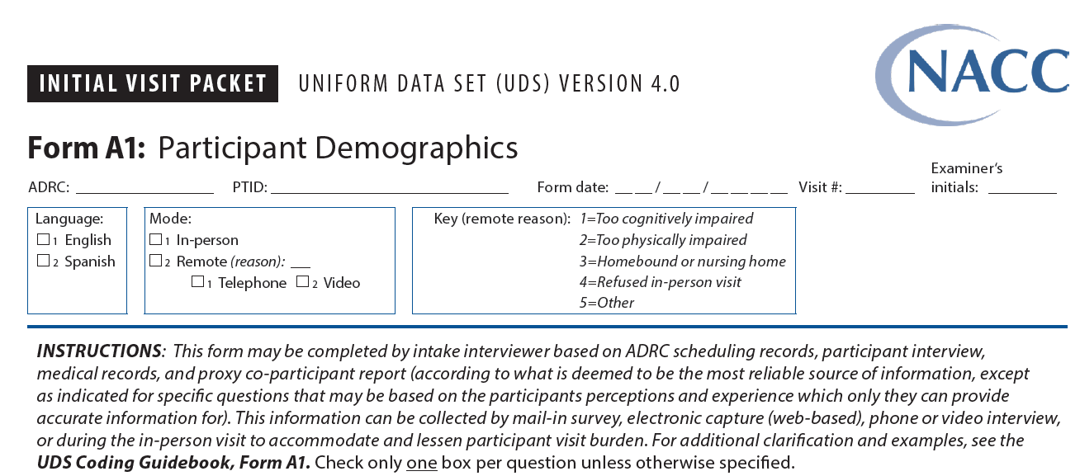
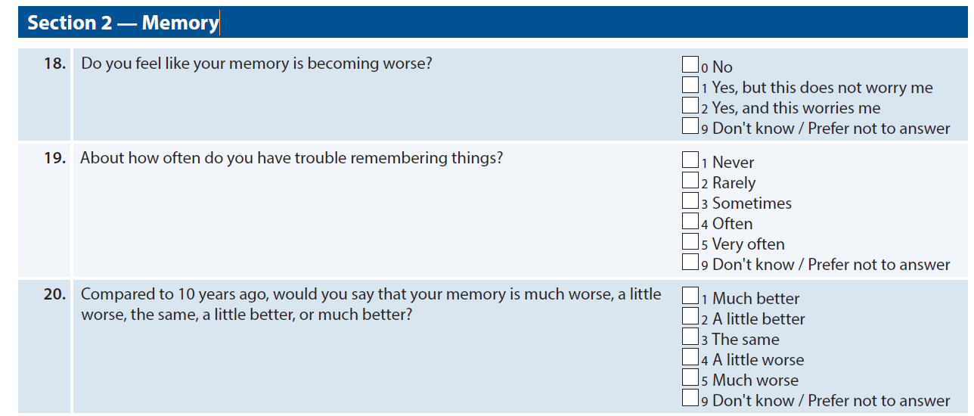
Form A1 SCD Self-Report Items
SCD clinical judgment but guidance will be provided for potential cut-off scores
Recommendation for further quantitative assessment of SCD symptoms:
Everyday Cognition (ECog) – 12 and 40 item version
Cognitive Change Index (CCI) – 12 and 20 item versions

Slide 34
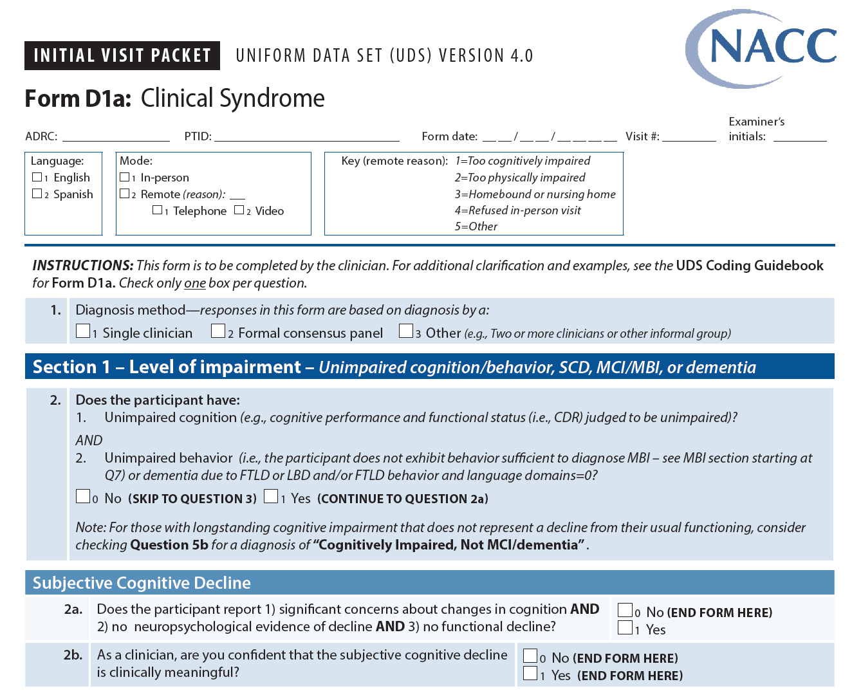
Form D1a SCD Items & Classification in UDS4

Slide 35
Form D1a SCD Item Under MCI Criteria

Slide 36
Connect
email
Andrew Saykin, PsyD (asaykin@iu.edu)

Slide 37
D1a Mild Behavioral Impairment (MBI)
Kostas Lyketsos, MD – Johns Hopkins ADRC
May 14, 2024 – UDSv4 Virtual Clinical Training Workshop

Slide 38
Case Study
72yo retired nurse referred to ADRC. In good health without significant co-morbidities. She has no psychiatric or substance use history.
In the last two years has began complaining of memory loss and trouble keeping track of appointments. Family sought help when she got lost while driving. She has a POSITIVE Florbetapir PET scan.
Diagnosis: Amnestic MCI due to AD.
Over the last 6 months she frequently has had notable changes in mood and behavior that have fluctuated but are getting worse. She currently has anxiety (NPI-Q=2), irritability (NPI-Q=2), loss of interest & social withdrawal (GDS=5). As a result, she stays home much of the time and gets angry when her husband encourages her to join him in activities. A few times in the last month she yelled at him about minor issues and threatened to divorce him.

Slide 39
X
X

Slide 40
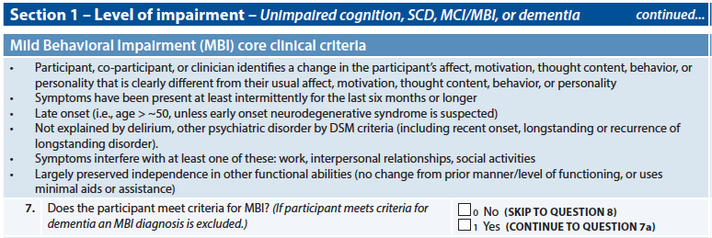
X
X
X
X
X
X

Slide 41
Case Study alternative 1
Participant currently noted to have anxiety (NPI-Q=2), irritability (NPI-Q=2), loss of interest & social withdrawal (GDS=5). These symptoms are not troubling and are not affecting the life of participant or her family.

Slide 42
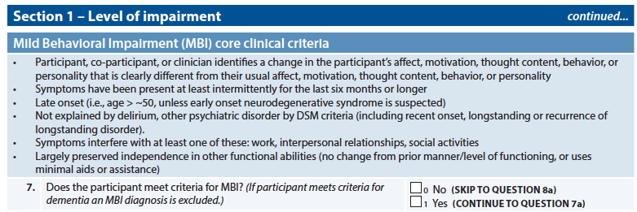
X

Slide 43
Case Study alternative 2
Participant has a history of depression with onset in her late 40s. She has been under-regular psychiatric care and has been doing well. GDS=5 and NPI-Q dysphoria=1. Her concentration is not very good, and she struggles to make decisions when her mood is low.

Slide 44
X

Slide 45
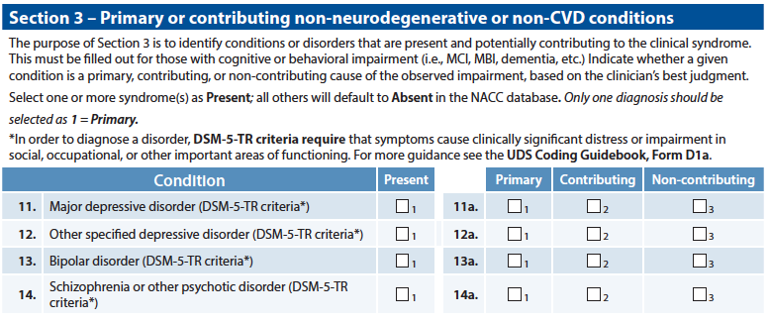
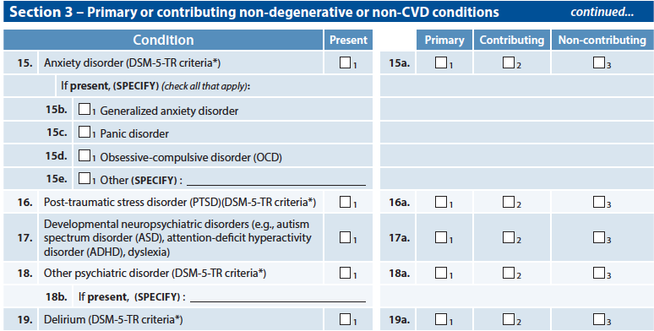
X
X
X

Slide 46
What’s New? Additional Criteria

Slide 47
What’s new?
Splitting D1 into 2 forms
D1a: Clinical Syndrome
D1b: Etiological Diagnosis and Biomarker Support
Added
Subjective Cognitive Decline (SCD)
Mild Behavioral Impairment (MBI)
Additional Criteria
MCI criteria
“Cognitive Impairment, Not MCI/Dementia”

Slide 48
Thank you!

Slide 49
Connect
Jeff Burns
jburns2@kumc.edu

