Slide 1
Form D1b: Etiological Diagnosis and Biomarker Support
Presented by: Jeffrey Burns, MD
May 14, 2024 – UDSv4 Virtual Clinical Training Workshop

Slide 2
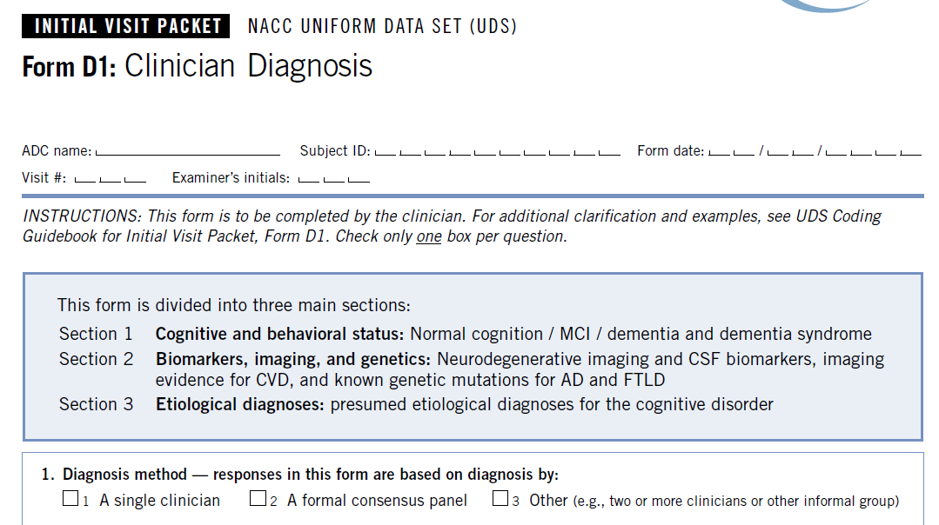
Old D1: Clinician Diagnosis → New D1a and D1b

Slide 3
Purpose of D1b
Assign etiological diagnosis
Document if biomarkers are used are used to support (or exclude) a diagnosis, based on local standards
The form is NOT intended to capture biomarker values or indicate sample availability
Allow future researchers to better understand how etiology was determined → clinical grounds alone vs clinical + biomarkers

Slide 4
D1b Organization
Biomarkers and Imaging
Fluid Biomarkers
Blood
CSF
Imaging
PET/SPECT
Tracer-based
FDG
DAT
Structural
Other
Etiological Diagnosis
AD
LBD
FTLD
VCI
Etc

Slide 5
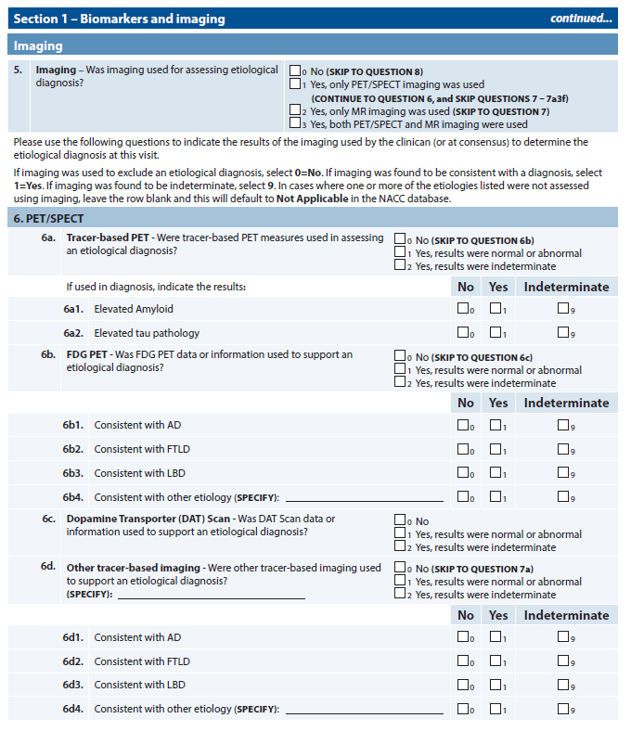
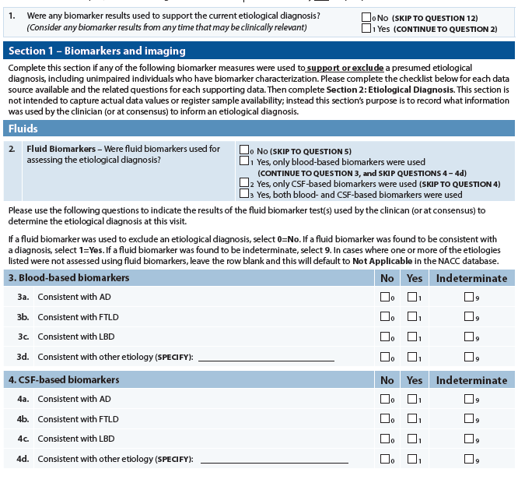
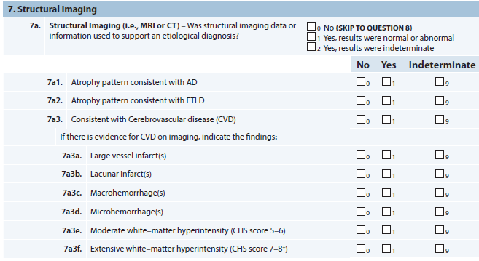
D1b: Etiological Diagnosis and Biomarkers

Slide 6
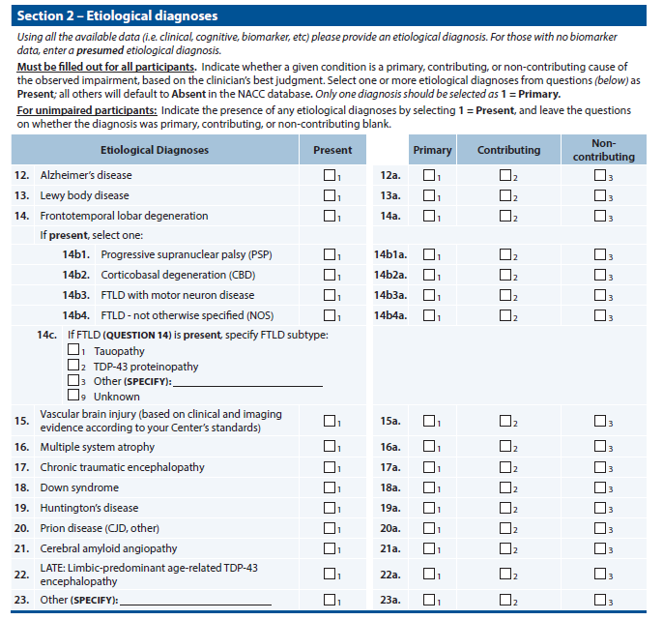
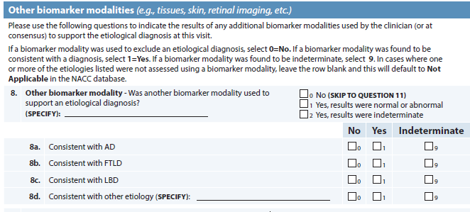
D1b: Etiological Diagnosis and Biomarkers

Slide 7
What’s new?
Splitting D1 into 2 forms
D1a: Clinical Syndrome
D1b: Etiological Diagnosis and Biomarker Support
Improved flow
Skip logic
More flexibility in reporting supportive biomarker results

Slide 8
Section 1: Biomarkers and Imaging

Slide 9
Section 1: Fluid Biomarkers

Slide 10
Section 1: Imaging

Slide 11
Section 1: Imaging

Slide 12
Section 1: Imaging

Slide 13
Section 1: Imaging

Slide 14
Section 1: Imaging

Slide 15
Section 1: Biomarkers and Imaging

Slide 16
Section 1: Other and Autosomal Dominant Genetics

Slide 17
Section 2: Etiological Diagnosis

Slide 18
Thank you!

